Slide 1
Detailed Balance & Monte Carlo
Marco Gibaldi
Notes:
ID=d924773e-9a16-4d6d-9803-8cb819e99682 Recipe=text_billboard Type=TextOnly Variant=0 FamilyID=AccentBoxWalbaum_Zero

Slide 2
Outline
Why use Monte Carlo methods?
How are Monte Carlo simulations performed?
What is Detailed Balance?
Is Detailed Balance Necessary?

Slide 3
Topic one: Why use Monte Carlo Methods?
a

Slide 4
Introduction
Canonical Ensemble
$$Q\left(N,V,T\right)= \sum_{j}{e^{−\frac{Ej\left(N,V\right)}{kT}}}$$
$$Pi= \frac{e^{−Ei/kT}}{Q\left(N,V,T\right)}$$
Recall, we can derive expressions for key thermodynamic properties IF we know how the energy levels are distributed
Only practical to solve analytically for a small number of systems (simple interactions & minimal number of entities in the system)
$$\left\langle M\right\rangle =\sum_{j}{M_{j}P_{j}}$$
$$S=kT{\left(\frac{∂lnQ}{∂T}\right)}_{N,V}+klnQ$$
$$Cv= \frac{d\left\langle E\right\rangle }{dT}=\frac{1}{kT^{2}}\left(\left\langle E^{2}\right\rangle −{\left\langle E\right\rangle }^{2}\right)$$

Slide 5
Option 1: Molecular Dynamics (MD)
Ergodic Hypothesis
Distribution of phase space points at long simulation times are equivalent to the ensemble probability distribution.
MD simulations propagate system according to Newton’s Equation(s) of Motion with different algorithms to determine the time-evolution of positions/forces
MD trajectories generate a series of phase space points over time in the defined ensemble
$$\left\langle M(X)\right\rangle = \lim_{t →∞}{\int_{0}^{t}{M_{x}}\left(\left\{r,p\right\};t^{′}\right)dt^{′}}$$
$= \int{\int{M\left(\left\{r,p\right\}\right)}P_{X}\left(\left\{r,p\right\}\right)dr dp}$

Slide 6
Option 2: Monte Carlo (MC) Simulations
MC provides path to the phase space probability distributions
Directly sample the configuration space of the ensemble
Method(s) rooted in random numbers! (stochastic)
No time evolution—cannot include any kinetic components of motion (focus=molecular interactions)

Slide 7
Topic two: How are Monte Carlo simulations performed?
a

Slide 8
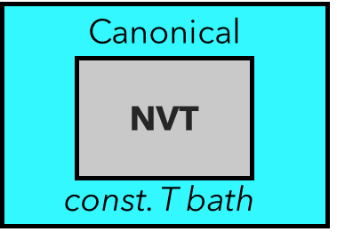
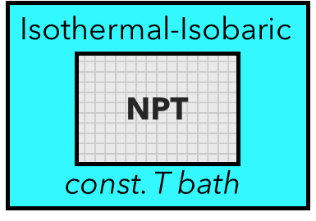
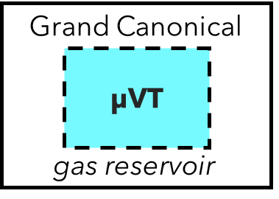
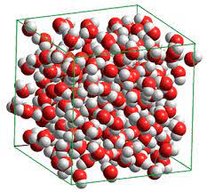
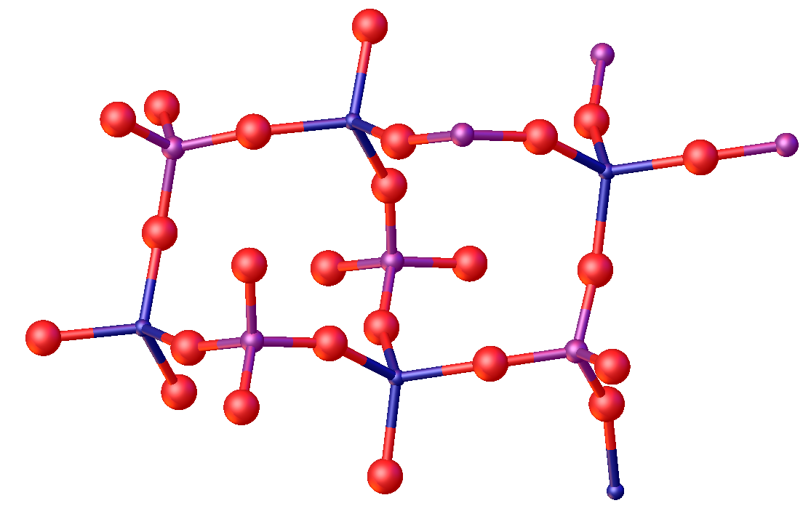
Getting Started
MC can sample various ensembles:
Canonical (NVT)
Isothermal-Isobaric (NPT)
Grand Canonical ( μVT)
Before starting, the system is placed in some initial configuration:
Solid → X-ray crystallographic data
Fluid → initial density close to the experimental properties

Slide 9
Configuration Hopping
Starting configuration
Random shifts in coordinates r_{i} of selected molecule(s) to generate new system configurations (or V_{system} / N_{system} depending on ensemble)
New configurations are accepted or rejected based on criteria relating to probability
Properties calculated by averaging the accepted configurations across all MC steps (N_{MC})
MC steps
$$\left\langle M(X)\right\rangle = \lim_{N_{MC} →∞}{\sum_{i=1}^{N_{MC}}{M({\left\{r\right\}}_{i};X)}}$$
New configuration(s)

Slide 10
MC Particle Dance
MC start at an initial configuration, {r}₀, then generates a chain of configurations {r}_{i} by sequentially changing small subsets of atoms from previous configurations {r}_{i−1}
Various sequences of MC moves can be imagined:
Moves must satisfy certain conditions, such as ergodicity and detailed balance (discussed later)
{r}_{i-1}
N₁
Translation
Rotation
Swapping
Particle Insertion
Particle Deletion
Etcetera.
{r}_{i}
…
× N_{MC}

Slide 11
Probability
Classical expression for probability density of N-molecule system in the Canonical Ensemble:
Absolute probability, P({r,p};N,V,T), for the system at coordinates {r} requires determination of the phase space integral of Q(N,V,T)
Complex potential energy functions = impossible
Relative probability between MC configurations can be determined instead
$$P(\left\{r,p\right\};N,V,T)= \frac{\frac{1}{N!h^{3N}}e^{−\sum_{i}{ \frac{p_{i}^{2}}{2m} /kT}}e^{−\frac{U\left(\left\{r\right\};N\right)}{kT}}}{Q(N,V,T)}$$

Slide 12
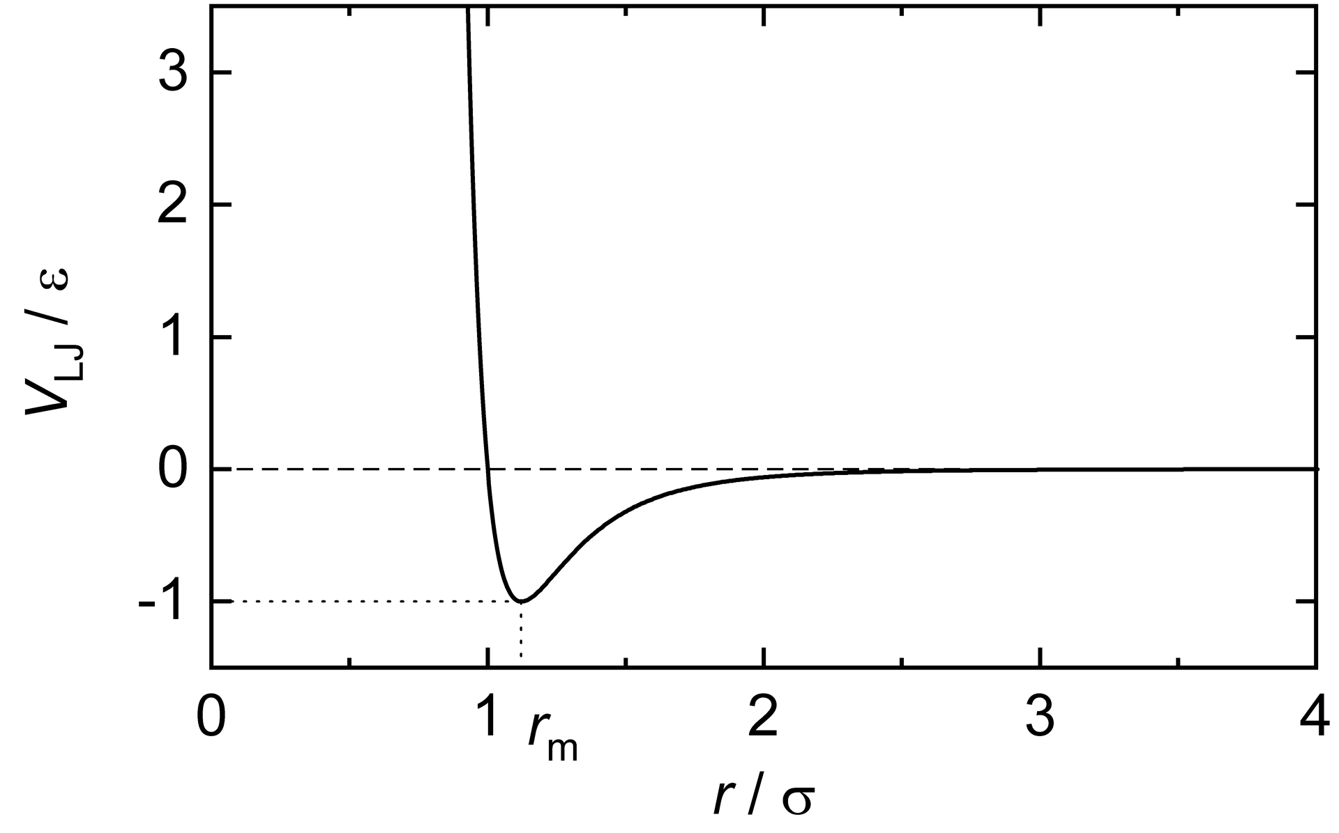
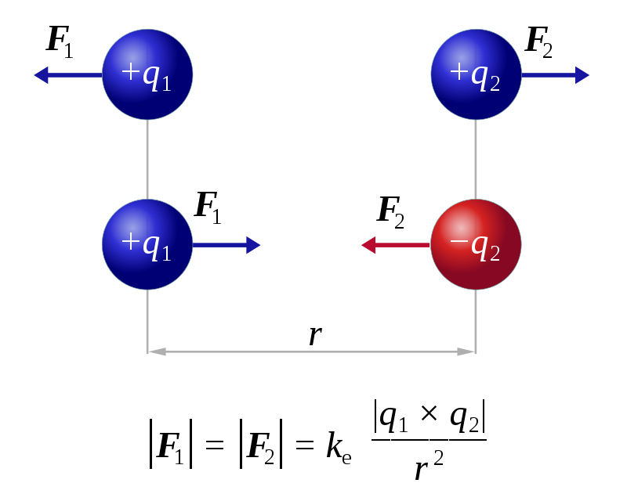
Potential Energy
MC studies a chain of stationary configurations → momentum is not necessary
Energy of any given configuration is calculated from the coordinates of all atoms, U({r};N,V)
Numerous short & long-range interactions are considered depending on the system
Coulombic interactions and other interatomic potentials usually considered
U({r};N,V) directly relates to probability
Lennard-Jones
Intermolecular Potential
Electrostatic
Interactions

Slide 13
Potential Energy & Probability
Consider two states in the Canonical Ensemble, state A → state B ,the ratio of their probabilities (with equal N,V,T) is given by:
Relative probability depends on the magnitude of their potential energies
Acceptance criterion for a new state generated by any given MC move will depend on how the potential energy of the system evolves
$$\frac{P(\left\{rB\right\};N,V,T)}{P(\left\{rA\right\};N,V,T)}= \frac{exp⁡(−U\left(\left\{rB\right\};N\right)/kT)}{exp⁡(−U\left(\left\{rA\right\};N\right)/kT)}$$
$=exp \{−[−U\left(\left\{rB\right\};N\right)−U\left(\left\{rA\right\};N\right)]/kT⁡$

Slide 14
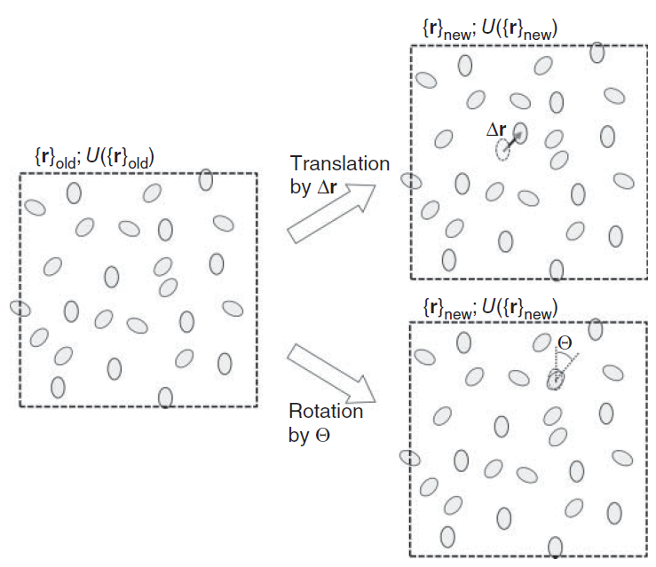
How does a MC simulation operate?
System begins at configuration {r}₀ with U({r}₀)
Select which MC moves to perform (via random number)
Select which molecule/particle will be changed (via random number)
Perform MC move to generate configuration {r}_{i} and calculate the new U({r}_{i})
Accept or Reject the new configuration based on the acceptance criterion (varies between ensemble & sampling methods)
Repeat for N_{MC} steps to calculate system properties/averages
Alavi, S. Molecular Simulations: Fundamentals and Practice, 1st ed.

Slide 15
Sampling Methods
Infinite number of configurations possible in the N-molecule phase space
Most configurations have high energy and low probability — inefficient to sample the entire space
Better to sample low energy regions (higher probability of contributing to the ensemble averages)
Popular method of achieving this is known as importance sampling or the Metropolis MC
Sample vicinity of more probable configurations
U({r})
Lower probability
$$\left\langle M\right\rangle =\sum_{j}{M_{j}P_{j}}$$
Higher probability

Slide 16
Importance Sampling
Key tenet: High energy states have low probability and do not contribute appreciably to ⟨M(X)⟩
Lower energy states prioritized—any new state with lower U({r}_{i}) should be accepted (guaranteed contribution to ⟨M(X)⟩ )
Higher energy configurations may still be accepted—likelihood reduces significantly with large values of ΔU (big deviations in U({r}_{x}) are penalized)
Follows concepts from Boltzmann distributions—with more efficient computation
U({r})
Lower probability
Higher probability
must sample here

Slide 17
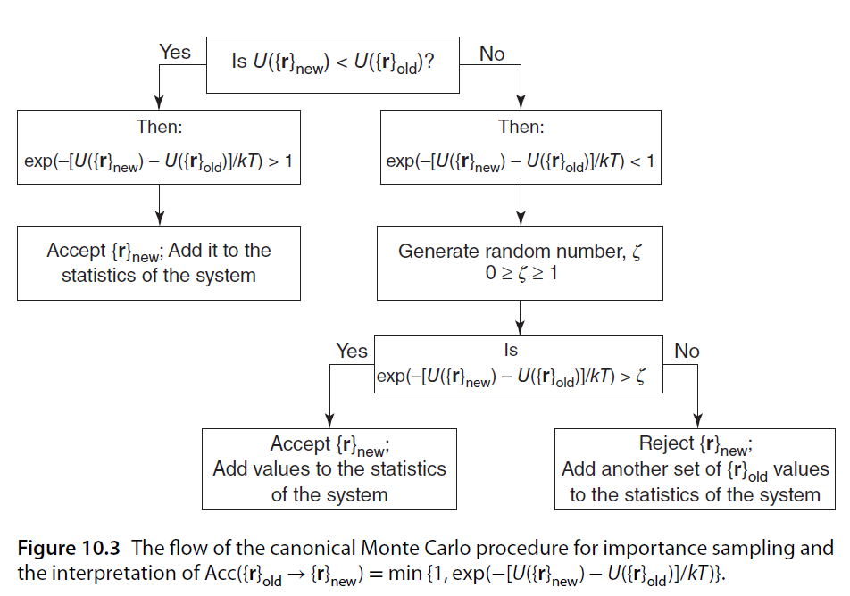
Acceptance Criteria—Importance Sampling
After performing MC move generating the new configuration, the probability of accepting that new configuration is:
If the new state has a lower energy, U({r}_{new}), the acceptance probability becomes 1 (exponential term is a positive value > 1)
If the new state has a higher energy, acceptance probability becomes the exponential term (depends on the magnitude of ΔU)
Typical flow of Canonical MC acceptance criteria.
$$Acc({\{r\}}_{old} → {\{r\}}_{new}) = min\{1, exp(−[U({\{r\}}_{new}) − U({\{r\}}_{old})]∕kT)\}$$
Alavi, S. Molecular Simulations: Fundamentals and Practice, 1st ed.

Slide 18
Acceptance Criteria—Importance Sampling
New state has a higher energy:
Accepted if 𝑒𝑥𝑝(−[𝑈({𝑟}_{𝑛𝑒𝑤}) − 𝑈({𝑟}_{𝑜𝑙𝑑})] /𝑘𝑇) > a selected random number between 0 & 1 (likely when ΔU is small)
Rejected if exponential term < random number (likely when ΔU is large; exp. term becomes small)
Accepted configuration is added to the rolling ensemble average calculations—simulation proceeds from accepted configuration(s) until N_{MC} is reached
Alavi, S. Molecular Simulations: Fundamentals and Practice, 1st ed.

Slide 19
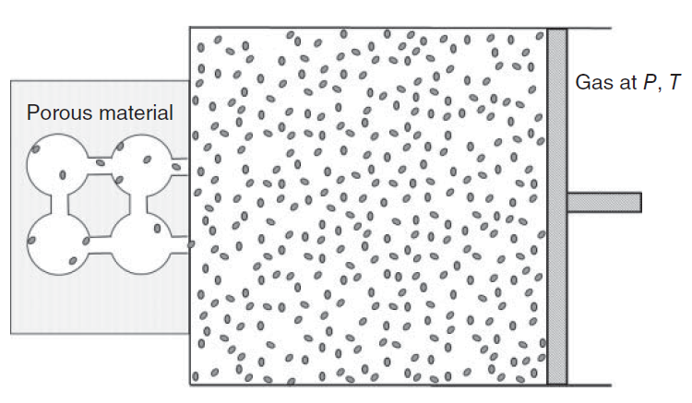
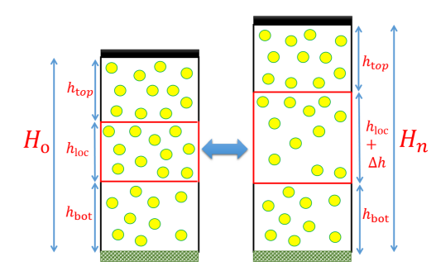
Other Ensembles/Applications of MC
General steps/forms can be extended to other ensembles with appropriate equations & MC sampling scheme(s)
Grand Canonical Monte Carlo (GCMC) can study absorption of gases onto interfaces or adsorption of a gas into a porous solid material
Isothermal-Isobaric MC can also be used to investigate fluids & surface wetting behaviour
Jain, K.; Rane, K. S.; Errington, J. R. J. Chem. Phys. 150, 2019, 084110

Slide 20
Ergodicity & MC
Every relevant point in the configuration space must be reachable throughout the simulation
Importance sampling still allows the low probability regions to be sampled—all regions in phase space are accessible
MC routines must be tuned (acceptance rates, MC move choice/magnitude, etc.) to ensure the proper ensemble probability distribution
{r}_{old}
{r}_{new}
Detailed Balance

Slide 21
Topic three: What is detailed balance?
a

Slide 22
Detailed Balance—Origins
Often called microscopic reversibility
Scheme must sample the system’s phase space and generate configurations distributed according to the ensemble probability distribution
Consider two MC states i & j at equilibrium, separated by a single random displacement or a series of random MC moves
Detailed balance requires that transitions between these two states must occur in a way that maintains the equilibrium ratio:
$$State\left(\left\{r\right\}i\right)⇄1…⇄N State(\{r\}j)$$
$$P(\{r\}i)∕P(\{r\}j) = exp(−[U(\{r\}i) − U(\{r\}j)]∕kT)$$

Slide 23
Detailed Balance
Transition probability in the forward (𝜋[{r}_{i} → {r}_{j}]) & reverse (𝜋[{r}_{j} →{r}_{i}]) processes at equilibrium should result in no flow between configurations:
Transition Probability can be further decomposed into the product of the transition matrix & acceptance rates
$$P\left(\left\{r\right\}i\right) π\left[\left\{r\right\}i → \left\{r\right\}j\right]= P\left(\left\{r\right\}j\right) π[\{r\}j → \{r\}i]$$
$$π\left[\left\{r\right\}i → \left\{r\right\}j\right]= T\left[\left\{r\right\}i → \left\{r\right\}j\right] Acc[\{r\}i → \{r\}j]$$
Relates to probability of generating a random transition that takes the system from {r}i to {r}_{j}

Slide 24
Detailed Balance—Outcomes
Random numbers 𝜁_{forward} that transition 𝑆𝑡𝑎𝑡𝑒({𝑟}_{𝑖})⇄₁…⇄_{𝑁} 𝑆𝑡𝑎𝑡𝑒({𝑟}_{𝑗}) must be as probable as the random numbers 𝜁_{reverse}
Limits choice in the MC schemes (e.g., move choices/magnitude, evolution of routine mid-simulation)
Transitions (single or multi-step) & MC routines must be designed to be equally mobile:
$$\frac{Acc(\{r\}j → \{r\}i)}{Acc(\{r\}i → \{r\}j) }= \frac{P(\{r\}i) }{P(\{r\}j) }= exp(−[U(\{r\}i) − U(\{r\}j)]∕kT)$$
Condition of Microscopic Reversibility (or Detailed balance)
$$Acc(\{r\}j → \{r\}i) =\frac{P(\{r\}i) }{P(\{r\}j)} Acc(\{r\}i → \{r\}j)$$

Slide 25
Will it (Detailed) Balance?
Consider the following examples and determine if they obey detailed balance
Molecule A undergoes series of translations & rotations:
{r}_{old}
{r}_{new}

Slide 26
Will it (Detailed) Balance?
Consider the following examples and determine if they obey detailed balance
Molecule B is translated in increments of 0.5 Å, then the translation increments are changed to 0.1 Å
Adjusting the translation and rotation increments breaks detailed balance
{r}_{old}
→ Δr = 0.5 Å
→ Δr = 0.1 Å
{r}_{new}

Slide 27
Topic four: Is detailed balance necessary?
a

Slide 28
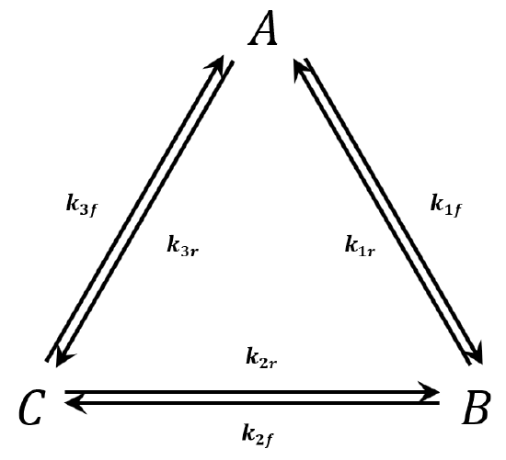
MC without Detailed Balance?
Arguments over how strict MC routines should be on detailed balance
Ergodicity + Detailed Balance ensure that the algorithm correctly samples the desired ensemble probability distribution
Can this still be true with a looser version of these restraints?
System-dependent → can it be more efficient to explore the phase space without detailed balance?

Slide 29
Strict Detailed Balance vs. Balance
Balance is a less strict condition —does not require the MC chain of configurations to converge towards the Boltzmann distribution
Instead, configurations must regularly sample the underlying distribution and leave the Boltzmann distribution invariant
Derivations¹ showing that balance is sufficient for several systems—harder to prove that a system follows balance
[1] Deem, M. W.; Manousiouthakis, V. I. J. Chem. Phys. 110 (6), 1999, 2753-2756

Slide 30
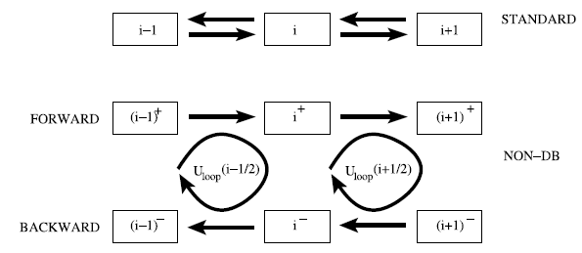
Beyond Detailed Balance—Examples
Non-detailed balanced MC proposed to better model the dynamics of systems where inertia matters
Acceptance probability is altered to maintain inertia
Moves in the undesired direction are reduced as much as possible (while maintaining ergodicity)
Applied to diffusion coefficients in model systems¹
Traditional MC sampling inefficient—molecules can alternate between forward/backward translation
[1] Schram, R. D.; Barkema, G. T. Physica A. 418, 2015, 88-93

Slide 31
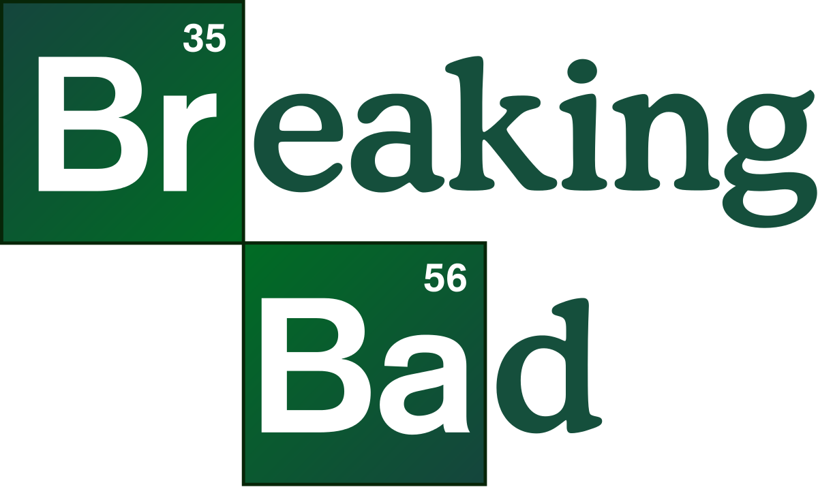
Breaking Detailed Balance
Systems at thermal equilibrium are known to obey detailed balance
Violating detailed balance can lead to more efficient MC routines:
Sequential updating that guarantees a pre-specified sweep of MC moves
Adjusting rejection rate by changing magnitude/probability of moves
And so on
Orkoulas, G.; O’Keefe, C.J.; Ren, R. Molecular Physics 105, 2007, 231-238

Slide 32
Summary
MC simulations are efficient methods of probing the ensemble probability distribution of macroscopic molecular systems
Ergodicity & Detailed Balance are vital conditions of MC simulations
Sophisticated MC methods do not necessarily need to obey detailed balance (only balance)

Slide 33
Thank you
Marco Gibaldi
mgiba006@uottawa.ca
Principally Adapted from:
Alavi, S. Molecular Simulations: Fundamentals and Practice, 1st ed.

Slide 34
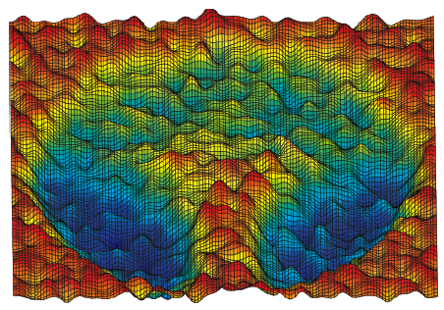
Monte Carlo (MC) Advantages
Efficient method for high-dimensional functions
Adapted to study various ensembles without time (or momentum) considerations
Widely applicable (used in science, finance, telecommunication, etc.) & customizable
No time-dependent properties (e.g., diffusion coefficient, vibrational spectra, etc.)
Canonical
Grand Canonical
NVT
μVT
const. T bath
gas reservoir

Slide 35
Will it (Detailed) Balance?
Consider the following examples and determine if they obey detailed balance
Molecule C rotates 15° clockwise—continued clockwise rotation is slightly more probable than in the counter-clockwise direction
Adjusting the translation and rotation increments breaks detailed balance

