Slide 1
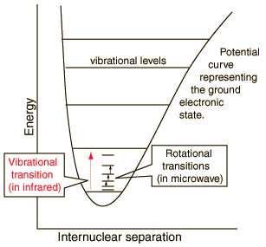
Statistical mechanics of an ideal diatomic gas: Rigid rotor
…
Energy levels of the rigid rotor
J = 2
J = 1
2B
6B
J = 0
J is the rotational quantum number
The rotational state wave functions correspond to the spherical harmonics (see H atom in quantum chemistry) and have even and odd symmetry (S, P, D, F, … orbital angular dependences)
Degeneracy of each energy level is 2J + 1
I is the moment of inertia of the molecule with respect to the center of mass ( )
B is the rotational constant

Slide 2
Symmetry of wave functions for diatomic molecules (1)
The Pauli Exclusion Principle
General Chemistry:
No two electrons in atomic or molecular orbitals can have the same four quantum numbers.
Electrons in the same atomic or molecular orbitals must have opposite spins
Physical / Quantum Chemistry:
The wave function for an atomic or molecular system must be anti-symmetric with respect to exchange of any pair of electrons (Fock – Slater determinant). This guaranties that each orbital only contains two electrons.
For example, for the He atom:

Slide 3
Symmetry of wave functions for diatomic molecules (2)
The Pauli Exclusion Principle
More general form:
The wave function for a system must be anti-symmetric with respect to exchange of any pair of Fermions (particles with half-integer spin ½, 3/2, … ), including electrons, muons, nuclei, …
The wave function for a system must be symmetric with respect to exchange of any pair of Bosons (particles with 0 or integer spin 1, 2, … ), including nuclei, …
Examples: Total wave function for exchange of ¹H nuclei in the H₂ molecule

Slide 4
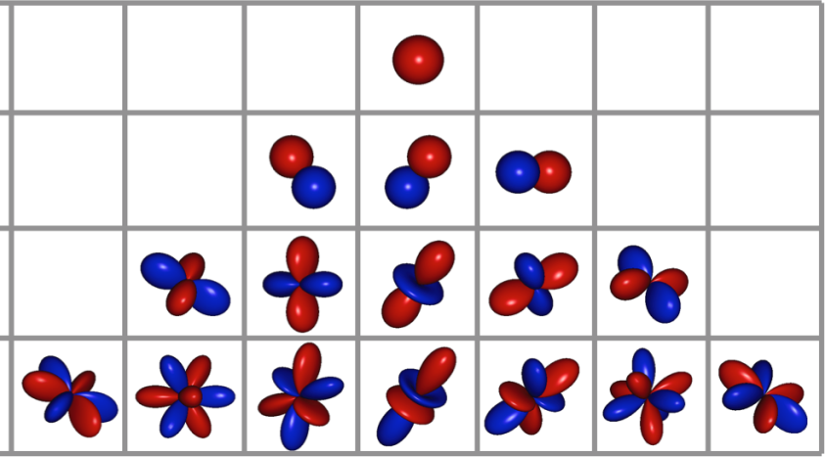
Symmetry of wave functions for diatomic molecules (3)
The exchange of nuclei in a diatomic (polyatomic) molecule is performed by a two-step process
1
x
2
The electrons and nuclei are inverted through the center of symmetry of the molecules
The electrons alone are inverted back through the center of symmetry
Symm: J even (S, D, …, spherical harmonics)
Antisymm: J odd (P, F, …, spherical harmonics)
Symmetric for both steps for most ground electronic states (in closed-shell species)
Symmetric under inversion
J = 0
J = 1
J = 2
J = 3
The symmetry of ψ_{nuc} is chosen to give ψ_{tot} the correct symmetry

Slide 5
Symmetry of wave functions for diatomic molecules (4)
Symmetry of nuclear wave function
Nuclei are Fermions (protons ¹H, ¹³C) and ψ_{tot} is antisymmetric with respect to nucleus exchange:
a) If the rotational wave function is anti-symmetric (J is odd)
ψ_{nuc} is symm. with respect to nucleus exchange (three states)
b) If the rotational wave function is symmetric (J is even)
ψ_{nuc} is symm. with respect to nucleus exchange (one state)
ortho-H₂ (↑↑) and para-H₂ (↑↓) are examples where the nuclear spin wavefunction is symm or anti-symm.
2) Nuclei are Bosons (¹²C, ²H, …) and ψ_{tot} is symmetric with respect to nucleus exchange:
a) If the nuclear spin is 0
Only symmetric rotational states (J even) are allowed
b) If the nuclear spin is integer

Slide 6
Rotational-nuclear Partition Function
For spin ½ nuclei
For spin 0 nuclei
In the high temperature limit many rotational states are accessible:
Riemann sum
f(x)
x

Slide 7
Rotational-nuclear Partition Function
Substitute the quantized energy levels of the rigid rotor in the partition function
In the general case of diatomic molecules
Symmetry number of molecule
For intermediate temperatures a more general form for the rotational partition function is:
Probability that a rotational state is occupied

Slide 8
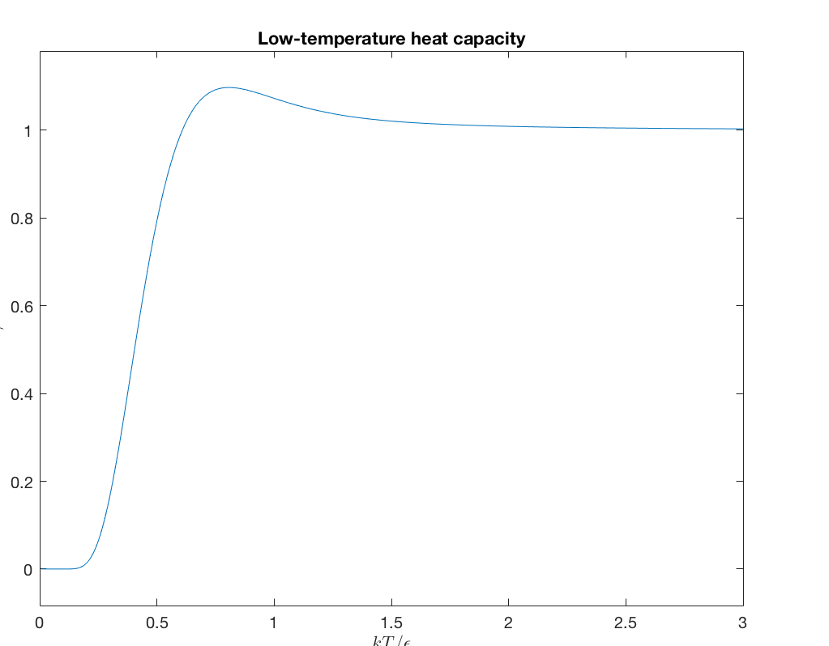
Rotational partition function
Symmetry number σ
σ = 1 for heteronuclear molecule (HCl)
σ = 2 for homonuclear molecule (Cl₂)
Typical behavior of rotational contribution to the heat capacity at constant V
C_{V,rot}/Nk
High temperature limit
T/Θ_{r}

Slide 9
Electronic Partition Function
For molecules, the electronic energy of the ground electronic state is measured with respect to the sum of the electronic energies of the separate atoms
Degeneracy of ground molecular state
Orbital angular momentum of molecular electronic states are shown with capital Greek letters in the molecular term symbol.

Slide 10
Parameters for diatomic molecules
Molecule | Electronic state | Θ_{v} / K | Θ_{r} / K | r_{eq} / Å | D₀ / eV
H₂ N₂ O₂ CO NO HCl HBr HI Cl₂ Br₂ I₂ |  | 6210 3340 2230 3070 2690 4140 3700 3200 810 470 310 | 85.4 2.86 2.07 2.77 2.42 15.2 12.1 9.0 0.346 0.116 0.054 | 0.740 1.095 1.204 1.128 1.150 1.275 1.414 1.604 1.989 2.284 2.667 | 4.454 9.76 5.08 9.14 5.29 4.43 3.60 2.75 2.48 1.97 1.54
Θ_{v} = hν/k. The vibrational states are mostly in the low temperature limit
Θ_{r} = B/k. The rotational states are mostly in the high temperature limit
Bond breaking through kinetic energy only occurs at very high temperatures

Slide 11
Thermodynamic Relations for Diatomic Molecules
The partition function of the system of N indistinguishable molecules
Thermodynamic variables
Ideal gas equation of state!

Slide 12
Thermodynamic Relations
Entropy
Gibbs free energy and the chemical potential
Standard chemical potential

Slide 13
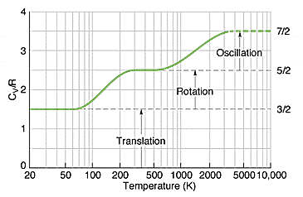
Significance of C_{V}
Shows transfer between kinetic energy (temperature) and potential energy
Behaviour of C_{V} for H₂
http://www.insula.com.au/physics/1221/L9.html
The stepwise increase in the heat capacity is a quantum mechanical behaviour

Slide 14
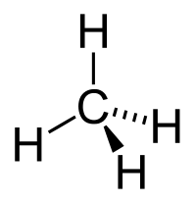
Polyatomic molecules in the ideal gas phase
The 3N degrees of freedom for a polyatomic molecule in Cartesian coordinates: {x₁,y₁,z₁, x₂,y₂,z₂,…, x_{N},y_{N},z_{N}}
Even if individual bonds are described by the harmonic oscillator model, it is not clear how we can separate the vibrations.
Mathematical techniques used in spectroscopy show the motion of a polyatomic molecule can be broken into independent contributions of:
Translational motion of the center of mass: {R_{cm,x} , R_{cm,y}, R_{cm,z}}
Three rotational motions about the three principle axes of rotation
3N – 6 normal modes of vibrational which are independent of each other. Normal modes are described by coordinates Q₁, Q₂, …Q_{3N-6} which are combinations of the motion of groups of atoms

Slide 15
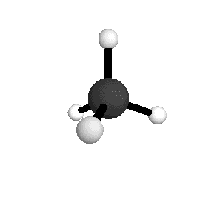
Normal vibrational modes for polyatomic molecules
Normal vibrational modes of water
Normal vibrational modes of methane
Symmetric stretch
A₁ symmetry
3025.5 cm⁻¹
Asymmetric stretch
F₂ symmetry
3156.8 cm⁻¹
Symmetric bend
F₂ symmetry
1367.4 cm⁻¹
Asymmetric bend
E symmetry
1582.7 cm⁻¹

Slide 16
Vibrational Partition Function
The Hamiltonian for normal vibrational modes for this system becomes:
Each of the normal modes is a harmonic oscillator with energy levels and frequency given by:
Substitute the expression for the partition function

Slide 17
Rotational states of a polyatomic gas
…
For linear polyatomic molecules (CO₂), energy levels are the same as for the diatomic molecule
J = 2
J = 1
2B
6B
J = 0
The moment of inertia with respect to the center of mass
For non-linear molecules, a set of Cartesian coordinates passing through the center of mass can be always chosen, called the principle axes, such that the three rotations about these axes are independent.
The moments of inertia about these axes are I_{A}, I_{B}, and I_{C} with three corresponding rotational constants,

Slide 18
Rotational states of a polyatomic gas
For spherical top molecules, I_{A} = I_{B} = I_{C}. The quantum mechanical spherical top molecule is solvable
… 25 states
J = 2
J = 1
Degeneracy of rotational state
J = 0
The characteristic rotational temperature are small and the high temperature limit of the partition function can be used
σ is the symmetry number of the molecule (number of pure rotational elements in the point group of the molecule in addition to the identity)
For methane σ = 12
http://symmetry.otterbein.edu/tutorial/methane.html

Slide 19
Rotational states of a polyatomic gas
For symmetric top molecules, I_{A} = I_{B} ≠ I_{C}. The quantum mechanical symmetric top molecule is solvable
J = 0, 1, 2, …
K = J, J – 1, J – 2, …, – J + 1, – J
Degeneracy of rotational state
The characteristic rotational temperature are small and the high temperature limit of the partition function can be used
For ammonia σ = 3

Slide 20
Rotational states of a polyatomic gas
For asymmetric top molecules, I_{A} ≠ I_{B} ≠ I_{C}. The quantum mechanical symmetric top molecule is solvable
The characteristic rotational temperature are small and the high temperature limit of the partition function can be used
For water σ = 2

Slide 21
Thermodynamic Relations for Linear Polyatomic Molecules
The partition function of the system of N indistinguishable molecules
Thermodynamic variables
Ideal gas equation of state!

Slide 22
Thermodynamic Relations for Nonlinear Polyatomic Molecules
The partition function of the system of N indistinguishable molecules
Thermodynamic variables
Ideal gas equation of state!

Slide 23
Parameters for polyatomic molecules
Molecule | Θ_{v} / K | Θ_{r} / K | D₀ / kcal/mol
CO₂ H₂O NH₃ ClO₂ SO₂ N₂O NO₂ CH₄ CH₃Cl CCl₄ | 3360, 954(2), 1890 5360, 5160, 2290 4800, 1360, 4880(2), 2330(2) 1360, 640, 1600 1660, 750, 1960 3200, 850(2), 1840 1900, 1980, 2330 4170, 2180(2), 4320(3), 1870(3) 4270, 1950, 1050, 4380(2), 2140(2), 1460(2) 660, 310(2), 1120(3), 450(3) | 0.561 40.1, 20.9, 13.4 13.6, 13.6, 8.92 2.50, 0.478, 0.400 2.92, 0.495, 0.422 0.603 11.5, 0.624, 0.590 7.54, 7.54, 7.54 7.32, 0.637, 0.637 0.0823, 0.0823, 0.0823 | 381.5 219.3 276.8 90.4 254.0 263.8 221.8 392.1 370.7 308.8

