Slide 1
Partition functions for perfect (non-interacting) gas systems
For indistinguishable molecules:
We can repeat the process of decomposing the partition function for the internal degrees of freedom of the molecule:
The 1-molecule canonical ensemble partition function decomposes to partition functions for different degrees of freedom:

Slide 2
How large are energy gaps between states?
Is the thermal energy (≈ kT) small or large compared to the difference between energy levels?
The relative magnitude of the thermal energy and the gaps between energy levels determines the level of approximation we use to evaluate the partition function.
Δε
kT
Low temperature limit;
Discreteness of energy levels matters
Sum over energy levels
High temperature limit;
Energy levels treated as quasi-continuous
Integrate over energy levels
It is useful to express energy separations in terms of temperature units kT;
Δε = kT is an energy separation which equals the thermal (kinetic) energy

Slide 3
High and low temperature limits
Energy level separations are expressed as characteristic temperatures: Θ = Δε / k
Low T limit:
High T limit:
Δε
kT
1 eV = 11,600 K = 96.485 kJ/mol 1/40 eV = 300 K (room temperature)
1 cm⁻¹ = 1.44 K
Electronic state separations: Δε ~ 0.05 to 20 eV (always low T limit)
Vibrational states: hν₀ ~ 1/40 eV to 0.5 eV (200 to 4000 cm⁻¹)
(room temperature is low T for molecules, high T for solids)
Rotational states: Θ_{rot} is usually < 2 K (most gases are in the high T limit)
Translational states: 3h²/8mL² ≈ 10⁻¹⁷ K (always high T limit)

Slide 4
Ideal monatomic gas: Translational degrees of freedom
The particle in a box is used to represent a simple gas of monatomic molecules
L
0
L
The translational partition function for each independent molecule
The ratio of h²/8mkT is very small so the sum is approximated by an integral:
f(x)
Riemann sum
Use this standard integral:
x

Slide 5
Determining thermodynamic variables from the partition function
The partition function of the system of N indistinguishable molecules
Thermodynamic variables
Same expression as classical mechanics
Ideal gas equation of state!
Sackur-Tetrode equation

Slide 6
Determining the chemical potential from the partition function
Chemical potential of an ideal gas
The chemical potential is the free energy change if a molecule is added or removed from the system

Slide 7
Effect of electronic states on the monatomic ideal gas partition function
The analysis above is for an ideal gas where all atoms are in the ground electronic state. At high temperatures, some atoms may have accessible electronically excited levels.
The electronic levels are independent of the translational motion of the atoms
q(V,T)=q_{trans}(V,T)q_{elec}(T)
There are usually only a few excited electronic levels with energies low enough that they accessible to the atom at temperatures below 1000 K. Under these conditions, only one to two terms in the expansion of the partition function contribute significantly to its value
ω₂
Δε₁₂
ω₁
The energy of the ground electronic level is used as the origin, ε₁ = 0
Electronic excitations are usually have energies between 0.05 to 20 eV
1 eV ↔ 38.94 kT ↔ 12000 K

Slide 8
Electronic states of gas phase atomic species
Atom | Electronic configuration | Term symbol / ^{(2S+1)} L_{J} | Degeneracy | Energy / eV
H | 1s¹ 2p¹ | ²S_{1/2} ²P_{1/2} | 2 2 | 0 10.2
He | 1s² 1s¹2s¹ | ¹S₀ ³S₁ | 1 3 | 0 19.82
Li | 1s²2s¹ 1s²2p¹ | ²S_{1/2} ²P_{1/2} | 2 2 | 0 1.85
O | 1s²2s²2p⁴ 1s²2s²2p⁴ 1s²2s²2p⁴ 1s²2s²2p⁴ | ³P₂ ³P₁ ³P₀ ¹D₂ | 5 3 1 5 | 0 0.02 0.03 1.97
F | 1s²2s²2p⁵ 1s²2s²2p⁵ | ²P_{3/2} ²P_{1/2} | 4 2 | 0 0.05
Total angular momentum
J = L + S, L + S – 1, …, | L – S|
S Spin angular momentum
L Orbital angular momentum

Slide 9
Diatomic ideal gas:
The rigid rotor – harmonic oscillator approximation
The six degrees of freedom for a diatomic molecule in Cartesian coordinates: {x₁,y₁,z₁, x₂,y₂,z₂}
In the rigid rotor – harmonic oscillator approximation, we describe the motion in terms of center of mass translational motion and internal vibrational and rotational motions
Translational motion of the center of mass: {R_{cm,x} , R_{cm,y}, R_{cm,z}}
Rotational motion of the molecule: {θ,ϕ}
Vibrational motion of the two atoms with respect to each other: {r_{rel}}

Slide 10
The statistical mechanics of the rigid rotor – harmonic oscillator model
In this framework, the rigid rotor-harmonic oscillator Hamiltonian can be separated into different contributions:
z
{x₁,y₁,z₁}
θ
Adding electronic degrees of freedom we have:
r_{rel}
y
ϕ
x
{x₂,y₂,z₂}
Rigid rotor – harmonic oscillator approximation for the partition function of a diatomic molecule

Slide 11
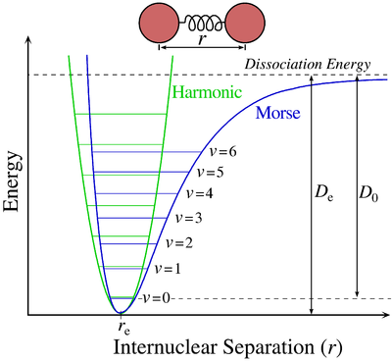
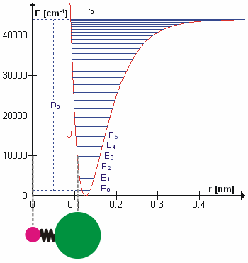
Statistical mechanics of ideal diatomic gases: The rigid rotor – harmonic oscillator approximation
Bonds energies are accurately represented by Morse potential with dissociation energy, D_{e}.
The vibrational levels of the Morse potential converge at high energies.

Slide 12
The rigid rotor – harmonic oscillator approximation
The dissociation energies are large and at normal temperatures diatomic molecules remain bound to each other
At normal temperatures, the molecules are confined near the potential minimum
The harmonic oscillator is a good approximation at low energies
At low energies, the range of vibrations are small relative to the bond length
The rigid-rotor is a good approximation for the rotational motion of the molecule

Slide 13
Vibrational Partition Function
Substitute the quantized energy levels of the harmonic oscillator in the partition function
The geometric series for x < 1
The partition function
High temperature limit of the partition function

Slide 14
Interpretation of the heat capacity
Heat capacity shows the transfer between kinetic energy (temperature) and potential energy
E_{vib}/NK
C_{V}/NK
T/Θ_{v}
T/Θ_{v}
C_{V}/NK
Δε
As the thermal energy becomes larger than the energy gap, heat capacity becomes a constant value
T/Θ_{v}

