Slide 1
Statistical mechanics of systems under constant pressure
How do we treat systems at constant pressure with statistical mechanics?
The system has constant pressure p, constant temperature T, with N interacting molecules;
The system has flexible walls which allow it to change volume to adjust the pressure;
The walls are thermally conducting, allowing exchange of heat energy with the surroundings
At each volume V_{k}, the N-molecule system as a whole is characterized by quantum state j with energy E_{i}
System:
-N molecules
-Pressure p
-Quantum states i (for each volume)

Slide 2
Set-up of the isothermal – isobaric ensemble
Replicas of the system are placed in contact with each other in a large thermal bath / barostat apparatus;
The walls of the systems are flexible allowing the volume of each system to change;
After equilibration, the ensemble is placed in an isolated container with fixed volume. This is called the isothermal-isobaric ensemble.
Isolated ensemble at fixed total energy E
Systems are enclosed in a rigid container of total volume V

Slide 3
How does the system volume enter into the quantum states?
Particle in a box quantum states depend on the volume of the box, V
V₂
V₁
Pressure for a particle in a box state n:

Slide 4
Distribution of systems in isothermal-isobaric ensemble among energy levels
The ensemble of systems are binned by placing each system into a slot corresponding first a particular volume, then to energy levels for that volume
A systems
E total energy
V total volume
First bin for volume
Second bin for energy level
Energy bins for V₁
Energy bins for V₂
Energy bins for V₃
…
E₁
E₂
E₃
E₄
E₅
A₁
E₆

Slide 5
The isothermal-isobaric ensemble
In the isothermal-isochoric ensemble different system volumes may be encountered.
Each volume V_{k} has its corresponding energy states E_{i}(V_{k})
N, p
E₂ (V₁)
N, p
E₃ (V₂)
N, p
E_{i} (V_{ℓ})
Constraints on the ensemble distribution
The continuous volume variation is
represented by the summation to simplify notation
The E, A and V are mathematical constructs

Slide 6
Most probable distribution in the isothermal-isobaric ensemble
The ways the members of the ensemble can be distributed among systems of volume V_{k} and states j
Constraints on the distribution
Each V_{k} has a set of associated energy levels E_{j}(V_{k})
Find the most probable distribution, subject to constraints of the system: Lagrange method of undetermined multipliers
Number of systems in ensemble with volume V_{ℓ} in state i in most probable distribution

Slide 7
Most probable distribution in the isothermal-isobaric ensemble
Number of systems in ensemble with volume V_{ℓ} in state i in most probable distribution
The probability of finding a system in the ensemble with volume V_{ℓ} and energy state E_{i}:
Isothermal – isobaric
partition function
The probability includes an energy factor and a volume factor!

Slide 8
Isothermal-isobaric partition function
Using the thermodynamic relation
We construct the statistical mechanical equivalent. Comparing the two allows us to identify the Lagrangian multipliers β and δ (see canonical ensemble derivation)
Average enthalpy:

Slide 9
Isothermal-isobaric partition function
Characteristic thermodynamics function for the isothermal-isobaric ensemble:
Alternative expressions for the isothermal-isobaric ensemble:
Sum over energy levels

Slide 10
Fluctuations in the enthalpy and volume distribution
The temperature derivative of the enthalpy is the heat capacity:
The distribution is very narrow for many molecule systems
Variance of the pressure distribution?
Does this relate to a thermodynamic quantity?
We can show:

Slide 11
Statistical mechanics of open systems: Grand canonical ensemble
Thermostat at T
Molecule reservoir at μ
The system set-up:
Constant volume
Molecule exchange with environment
Heat exchange with the environment
Semi-permeable membrane
Volume V
Molecules μ
Quantum state i
A system of constant volume which can exchange heat and molecules with the surroundings;
For each number of molecules, the system as a whole is characterized by a quantum state E_{i}(N)
E₁(1), E₂(1), E₃(1), …, E_{i}(1), …
E′₁(2), E′₂(2), E′₃(2), …, E′_{i}(2), …
E″₁(3), E″₂(3), E″₃(3), …, E″_{i}(3), …
…
E₁(N), E₂(N), E₃(N), …, E_{i}(N), …
11

Slide 12
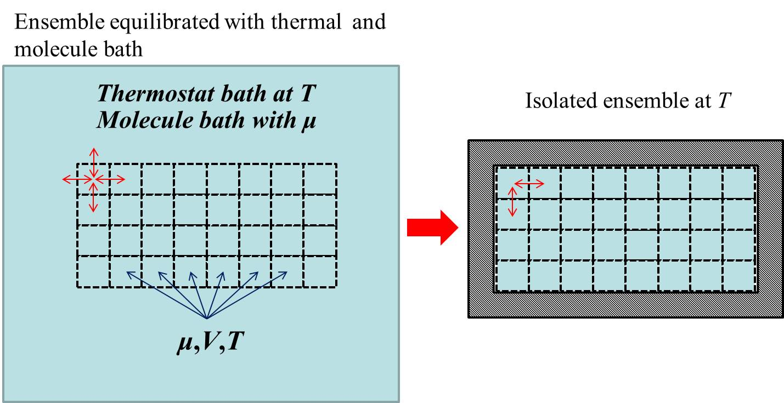
Grand canonical ensemble – Open systems
The N-molecule system as a whole is characterized by a quantum state E_{i}
Replicas of the system are placed in contact with each other in a large thermal bath / molecule bath
After equilibration, the replicas which now have the same μ, T, and V are placed in an isolated container
Isolated ensemble at T and μ
Total energy in the ensemble E,
Total number of systems in the ensemble A , Total number of molecules in the ensemble N
The grand canonical ensemble can be called the isopotential-isothermal-isochoric ensemble

Slide 13
Distribution of systems in grand canonical ensemble among energy levels
The ensemble of systems are binned by placing each system into a slot corresponding first a particular number of molecules, then to energy levels for that volume
A systems
E total energy
N total molecules
First bin for no. of molecules
Second bin for energy level
Energy bins for N₁
Energy bins for N₂
Energy bins for N₃
…
E₁
E₂
E₃
E₄
E₅
A₁
E₆

Slide 14
The energy states of ideal gas systems with different numbers of molecules
one-particle quantum states
two-particle quantum states
Find the most probable distribution for the states in the grand-canonical ensemble, subject to constraints of the system,
Constraints on the system:
μ,V,T
E_{,j}(N₁)
μ,V,T
E_{k}(N₇)
μ,V,T
E_{i}(N_{ℓ})

Slide 15
Most probable distribution for the Grand Canonical Ensemble
The ways the ensemble can be distributed among systems with N molecule and state i
Constraints on the distribution
Find the most probable distribution, subject to constraints of the system,
Number of systems in ensemble with N molecules in state j in most probable distribution
Grand canonical partition function
Greek letter xi
Probability includes energy (Boltzmann) factor and molecule number factor.

Slide 16
Thermodynamic relations for the grand canonical ensemble
Thermodynamic relations:
We construct the statistical mechanical equivalent of a thermodynamic relation and compare the two to identify the Lagrange multipliers β and γ

Slide 17
Grand canonical partition function
Adding to both sides of the last equation gives:
Compare this to the thermodynamic relation:
Gives:
pV is the characteristic function of the grand canonical ensemble
Write the grand canonical partition function in terms of energy levels

Slide 18
Fluctuations in the number of molecules in the grand canonical distribution
The variance of the number of molecule in the systems:
The distribution is very narrow for many molecule systems
The distribution is very narrow for many molecule systems
The distribution of the number of particles is narrow Gaussian function for many molecule systems

Slide 19
Microcanonical (isoenergy, isochoric) ensemble
Each system is confined to
a constant volume
a constant energy
NVE
NVE
NVE
NVE
NVE
NVE

