Slide 1
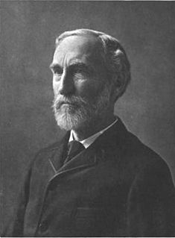
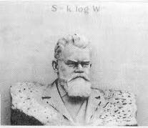

Statistical Mechanics - Ensembles
Boltzmann and Gibbs ensemble methods for systems with interacting particles
Ludwig Boltzmann
(1844 – 1906)
J. Willard Gibbs
(1839-1903)

Slide 2
Energy distribution of systems with interacting molecules or systems interacting with the environment
In non-interacting systems, the total energy is subdivided into a sum of one molecule energies.
The probability distribution for E_{tot} is the product of independent single molecule energy probabilities
In interacting systems, the total energy cannot be subdivided into a sum of one molecule energies. Interactions between molecules also contribute to the energy
The probability distribution for E_{tot} is not the product of independent single molecule energy probabilities

Slide 3
Energy distribution of systems with interacting molecules or systems interacting with the environment
How do we find the distribution of velocity and positions for systems with interactions?
Do attractive forces increase the probability of finding molecules closer together?
Do repulsive forces increase the probability of finding molecules farther apart?
Interactions between molecules lead to cause spatial and energetic correlations between neighboring molecules

Slide 4
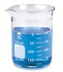
The game plan for statistical mechanics
Our goal: Given what we know about the microscopic structure of the system, how do we determine macroscopic behavior of the system?
We know the values of a limited number of macroscopic thermodynamic variables of a system, such as the total energy, amount of substance, temperature, pressure, … (the macrostate of the system)
We know the nature of the individual molecules (structure, energy levels, etc.) and their interactions with other molecules in the system
How can we determine the possible microstates that are consistent with whatever constraints we have related to the macrostate of the system?
Once we know the possible microstates, how can we determine the other macroscopic properties of the system given knowledge of the microstates?

Slide 5
Distributing molecules among quantized energy levels to give a fixed total energy
Given what we know about the discrete quantum states of the system, how do we determine the most probable the distribution of molecules among the states consistent with the known macroscopic information on the system?
The system has discrete energy levels spaced according to the specific details of the case
…
ε₆
ε₅
ε₄
ε₃
ε₂
ε₁ = 0
The problem is somewhat are analogous to determining the discrete outcomes of the role of dice
The additional feature of statistical mechanics is that we need to find distributions of molecules among the levels (microstates) satisfying two (or more) physical constraints
The total number of molecules in the system is constant
The total energy of the system is constant

Slide 6
Distribution of non-interacting molecules among discrete quantum states
How does the approach work for a system of non-interacting molecules?
Take an isolated ideal gas system of N molecules with the total energy E_{tot}
L
Total energy of the N-molecule quantum state:
Each molecule is in a particle-in-box quantum state n_{i} = {n_{xi}, n_{yi}, n_{zi}} characterized by energy ε_{i}
0
L
One possible distribution of molecules among energy levels to give E_{tot}:
In the N-molecule system:
a₁ molecules are in state 1,
a₂ molecules are in state 2,
…,
a_{i} of the molecules may be in state i,
...
ε₆
ε₅
a₆ = 1
a₅ = 2
ε₄
ε₃
ε₂
a₄ = 5
a₃ = 1
a₂ = 2
ε₁
6
a₁= 4
Notes:
6
CHM 4390 C / 8309

Slide 7
Distribution of non-interacting molecules among quantum states
All molecules are binned by placing each according to its quantum state into a slot with its corresponding discrete energy
Bins for each state are labelled with the energy
N molecules
E total energy
ε₁
ε₂
ε₃
ε₄
ε₅
a₁
ε₆
ε_{j}
ε_{j+1}
∙∙∙
Quantum state energy ε₁ ε₂ ε₃ ε₄ ε₅ …
Occupancy of level a₁ a₂ a₃ a₄ a₅ …
The distribution of molecules among states must satisfy the constraints:
The total occupancies must equal the number of molecules
The total energy of system is fixed
How many ways can each binning (set of a_{j} values) be achieved?

Slide 8
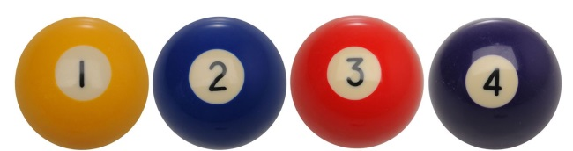


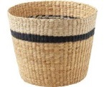




Number of ways of distributing distinguishable objects among bins
How many ways are there to place one object from a collection of four into a single bin?
How many ways are there to place two objects from a collection of four into a single bin
W = 4
possible ways
W = 4×3 possible ways
If the order of placing the objects into the bins is not important, not all ways are different (6 distributions are distinct)

Slide 9

Distributing all distinguishable objects among bins
Ways of arranging four distinguishable objects
{1234}{1243}{1324}{1342}{1423}{1432}
{2134}{2143}{2314}{2341}{2413}{2431}
{3124}{3142}{3214}{3241}{3412}{3421}
{4123}{4132}{4213}{4231}{4312}{4321}
4! = 4×3×2×1
How many ways are there to bin the four distinguishable objects into two groups?
{(12)(34)}{(12)(43)}{(13)(24)}{(13)(42)}{(14)(23)}{(14)(32)}
{(21)(34)}{(21)(43)}{(23)(14)}{(23)(41)}{(24)(13)}{(24)(31)}
{(31)(24)}{(31)(42)}{(32)(14)}{(32)(41)}{(34)(12)}{(34)(21)}
{(41)(23)}{(41)(32)}{(42)(13)}{(42)(31)}{(43)(12)}{(43)(21)}
Ways of binning four distinguishable objects into two groups of 2 and 2
{(123)(4)}{(124)(3)}{(132)(4)}{(134)(2)}{(142)(3)}{(143)(2)}
{(213)(4)}{(214)(3)}{(231)(4)}{(234)(1)}{(241)(3)}{(243)(1)}
{(312)(4)}{(314)(2)}{(321)(4)}{(324)(1)}{(341)(2)}{(342)(1)}
{(412)(3)}{(413)(2)}{(421)(3)}{(423)(1)}{(431)(2)}{(432)(1)}
Ways of binning four distinguishable objects into two groups of 3 and 1

Slide 10


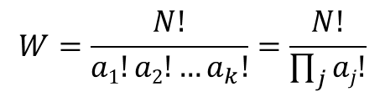
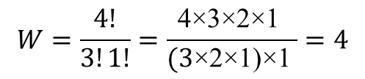
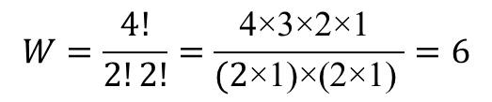
Distributing all distinguishable objects among bins
However, if the order of the balls in the bins is not important, the distinct distributions are color coded below:
Distinct binning of 4 distinguishable objects into bins in groups of 2 and 2 regardless of order in bins
{(12)(34)}{(12)(43)}{(13)(24)}{(13)(42)}{(14)(23)}{(14)(32)}
{(21)(34)}{(21)(43)}{(23)(14)}{(23)(41)}{(24)(13)}{(24)(31)}
{(31)(24)}{(31)(42)}{(32)(14)}{(32)(41)}{(34)(12)}{(34)(21)}
{(41)(23)}{(41)(32)}{(42)(13)}{(42)(31)}{(43)(12)}{(43)(21)}
$$W=\frac{4!}{2!2!}=\frac{\text{4}\text{×}\text{3}\text{×}\text{2}\text{×}\text{1} }{\text{(}\text{2}\text{×}\text{1)}\text{×}\text{(}\text{2}\text{×}\text{1}\text{)} }=6$$
a₁ = 2
a₂ = 2
Distinct binning of 4 distinguishable objects into two bins in groups of 3 and 1 regardless of order in bins
{(123)(4)}{(124)(3)}{(132)(4)}{(134)(2)}{(142)(3)}{(143)(2)}
{(213)(4)}{(214)(3)}{(231)(4)}{(234)(1)}{(241)(3)}{(243)(1)}
{(312)(4)}{(314)(2)}{(321)(4)}{(324)(1)}{(341)(2)}{(342)(1)}
{(412)(3)}{(413)(2)}{(421)(3)}{(423)(1)}{(431)(2)}{(432)(1)}
$$W=\frac{4!}{3!1!}=\frac{\text{4}\text{×}\text{3}\text{×}\text{2}\text{×}\text{1} }{(\text{3}\text{×}\text{2}\text{×}\text{1)}\text{×}\text{1} }=4$$
a₁ = 3
a₂ = 1
Distinct binning of N distinguishable objects into k bins groups of a₁ , a₂, …, a_{k} regardless of order in bins
$$W=\frac{N!}{a1!a2!…a_{k}!}=\frac{N!}{\prod_{j}{aj!}}$$
… k
Product sign:
multiplication over all bins
… N

