Slide 1

Probability distribution in the ensemble
Probability of observing a particular state i in most probable distribution
“Canonical” ensemble
(isothermal-isochoric ensemble)
partition function for system states
Averages of quantities can be calculated from knowledge of the probabilities

Slide 2
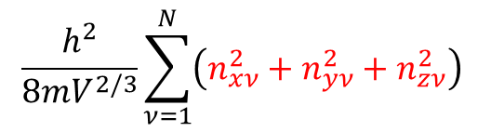
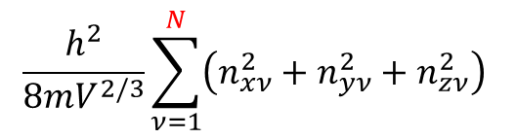
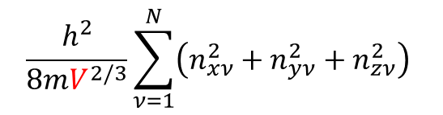
Ways to change the ⟨E⟩ of a N-molecule ideal gas system
Change the distribution of molecules among the states
Change the volume V (which changes energy levels) without changing the distribution
Change the number of molecules in the system without changing the levels
Σ_{j}E_{j}(N,V)P_{j}(N,V,T)
$$\frac{h^{2}}{8mV^{2/3}}\sum_{ν=1}^{N}{\left(n_{xν}^{2}+n_{yν}^{2}+n_{zν}^{2}\right) }$$
Σ_{j}E_{j}(N,V)P_{j}(N,V,T)
$$\frac{h^{2}}{8mV^{2/3}}\sum_{ν=1}^{N}{\left(n_{xν}^{2}+n_{yν}^{2}+n_{zν}^{2}\right) }$$
Important for open systems
(grand Canonical ensemble)
$$\frac{h^{2}}{8mV^{2/3}}\sum_{ν=1}^{N}{\left(n_{xν}^{2}+n_{yν}^{2}+n_{zν}^{2}\right) }$$

Slide 3
Statistical mechanical interpretation of work and heat
Thermodynamic expression for energy change:
Energy can change by performing work or transfer of heat:
Statistical mechanical expression for energy change:
The ensemble average energy can varied by:
Changing the system energy levels while keeping probabilities (i.e., distribution of systems among the levels) fixed
Changing the probabilities for distribution among the energy levels
In the particle in a box, the energy levels can be changed by varying the volume of the system:
Therefore
corresponds to change of energy due to work
and
must correspond to transfer of heat
3
Notes:
3
CHM 4390 C / 8309

Slide 4
Statistical mechanics and thermodynamic functions
Can be shown that:
(see Extended Lecture Notes)
From the thermodynamic relation A = E – TS, we can determine the statistical mechanical expression for the Helmholtz free energy:
We get the simple relation:
The canonical partition function is the “characteristic” function for the Helmholtz free energy
We can use the second law of thermodynamics expression:
to relate thermodynamic quantities to the canonical ensemble partition function.
4
Notes:
4
CHM 4390 C / 8309

Slide 5
Fluctuations in the energy distribution
How wide is the energy distribution?
Starting from the relation for the average energy of the ensemble of systems
The temperature derivative of the energy is the heat capacity:
For a monatomic ideal gas, C_{V} = 3Nk/2 and so

Slide 6
Fluctuations in the energy distribution
The probability distribution for the energy in a canonical ensemble is:
Expanding the probability distribution about the average energy and neglecting terms of order 1/N² or smaller, we can get a Gaussian distribution for the energy in a canonical ensemble is:
Variance of the pressure distribution?
We can show:

Slide 7
Boltzmann statistics for indistinguishable molecules
Consider a system made of N non-interacting molecules, but allowing for interactions between atoms within each molecule:
Expression for the partition function for distinguishable molecules:
Quantum states of the
N-molecule system
Quantum states of the
individual molecules
One-molecule partition functions
For indistinguishable molecules:
N! ways of distributing the N indistinguishable molecules among the states

Slide 8
Partition function q(V, T) expressed as sum over energy levels
Assume we have a molecular system with nine states
ε₃ =2Δ
ε₂ =1Δ
ε₁ = 0
Sum over one-molecule states
Gather similar terms
Sum over one-molecule energy levels
Degeneracy of the energy state
Expressing the partition function as a sum over energy levels shows the physical content of this function more clearly.

Slide 9
Physical interpretation of the canonical partition function for non-interacting molecules
ε₃ =2Δ
ε₂ =1Δ
ε₁ = 0
Assume we have a system with nine states
Δ
Δ
The partition function is:
Changes in partition function and probability of energy levels with temperature
T (in Δ/k units) 0 0.5 1.0 1.5 2.0 5.0 10.0 → ∞
q(T) 3 3.34 4.28 5.08 5.68 7.32 8.08 → 9
P₁ = 3e^{-0/kT}/q 1 0.90 0.70 0.59 0.53 0.41 0.37 → 0.33
P₂ = 2e^{-Δ/kT}/q 0 0.08 0.17 0.20 0.21 0.22 0.22 → 0.22
P₃ = 4e^{-2Δ/kT}/q 0 0.02 0.13 0.21 0.26 0.37 0.41 → 0.44

Slide 10
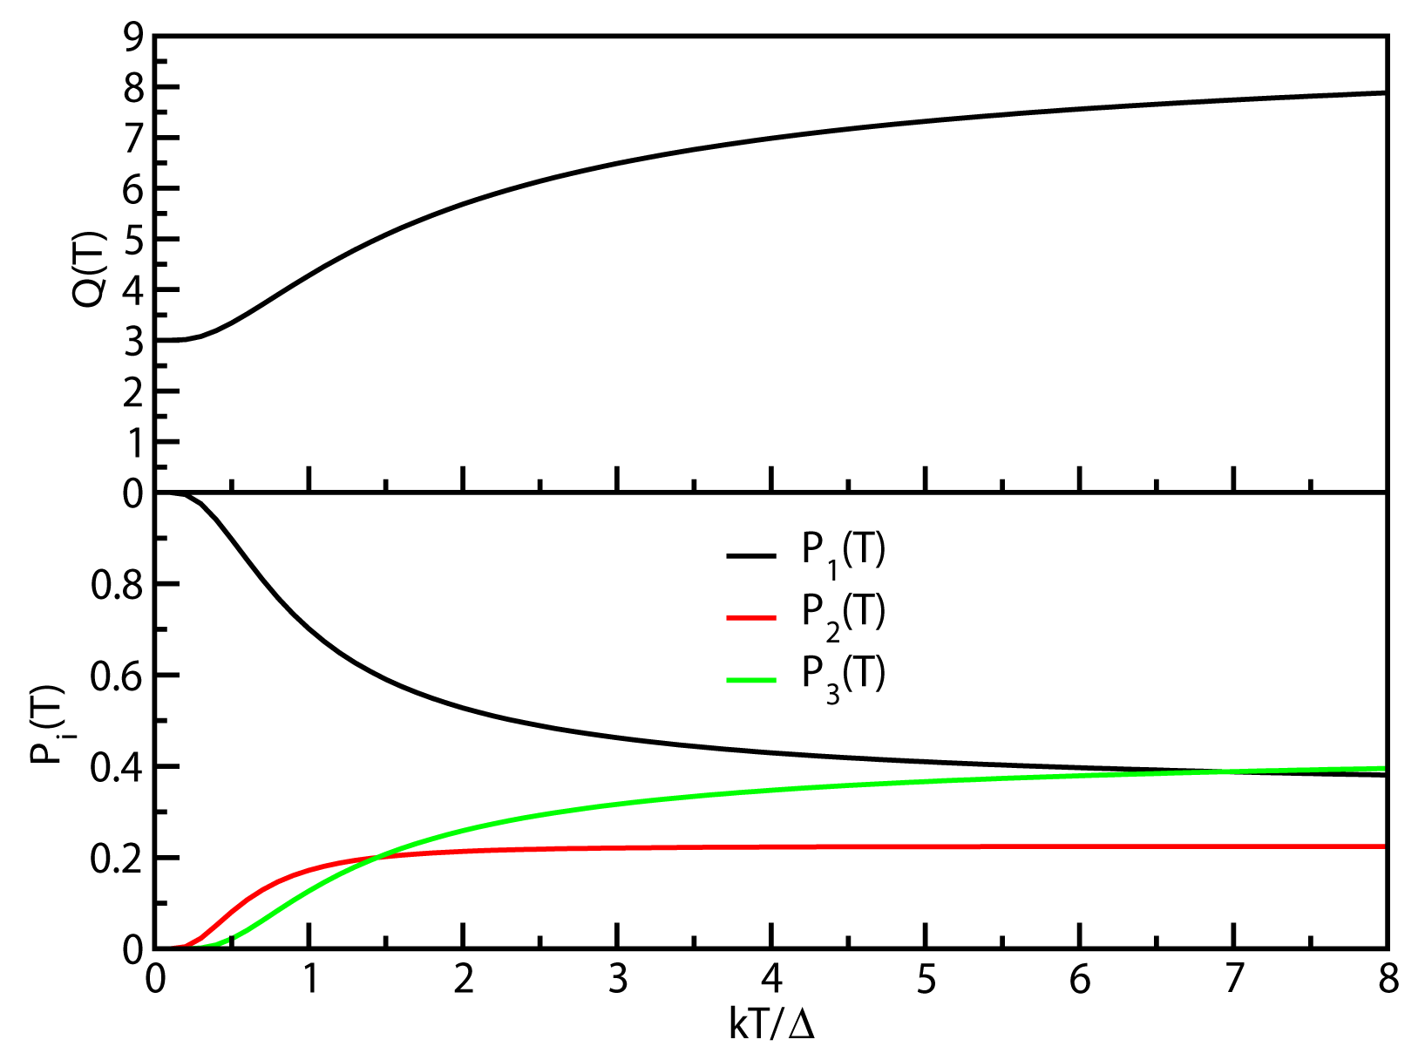
Physical interpretation of the canonical partition function
ε₃ = 2Δ
ε₂ = 1Δ
ε₁ = 0
Probability of occupancy of
energy level E
Variation of partition function with temperature
P₁ = 3e^{-0/kT}/q
P₂ = 2e^{-Δ/kT}/q
P₃ = 4e^{-2Δ/kT}/q
Variation of probabilities with temperature
The partition function gives a measure of the number of states accessible to the system at the given temperature

Slide 11
Partition functions for non-interacting systems
We can repeat the process of decomposing the partition function for the internal degrees of freedom of the molecule:
The 1-molecule canonical ensemble partition function decomposes to partition functions for different degrees of freedom:
Using quantum mechanical expressions for the translational, rotational, vibrational, and electronic energies, we can determine the partition function for each of these degrees of freedom.

Slide 12
Phase space probability distribution of an ideal gas molecule
The phase space for an ideal gas at constant energy {r₁,p₁,r₂,p₂, …, r_{N}, p_{N}}:
Molecules are uniformly distributed in the volume of the system and their momentum components are distributed according to the Maxwell (Gaussian) distribution;
Many possible distributions of positions and momenta of
the molecules are possible which give the same total energy, E_{N}.
Spatial distribution of molecules: Probability of finding molecule 1 at r within the volume element, dr = dxdydz:
Momentum distribution of the molecules: Probability of molecule 1 having momentum p within the momentum element dp = dp_{x}dp_{y}dp_{z}:

Slide 13
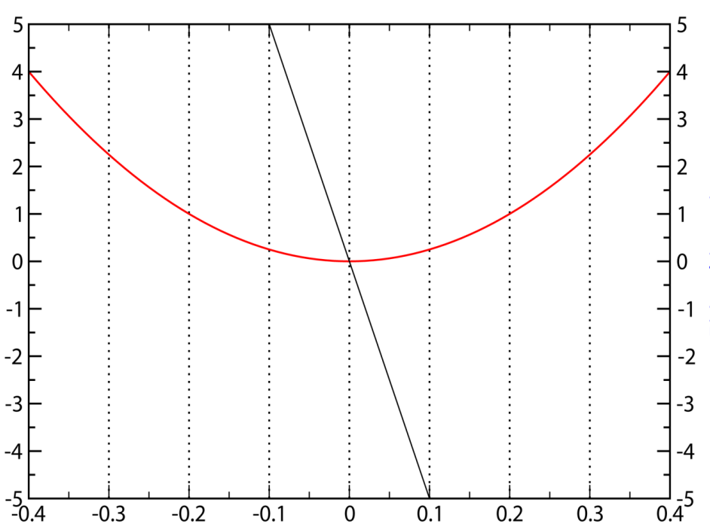
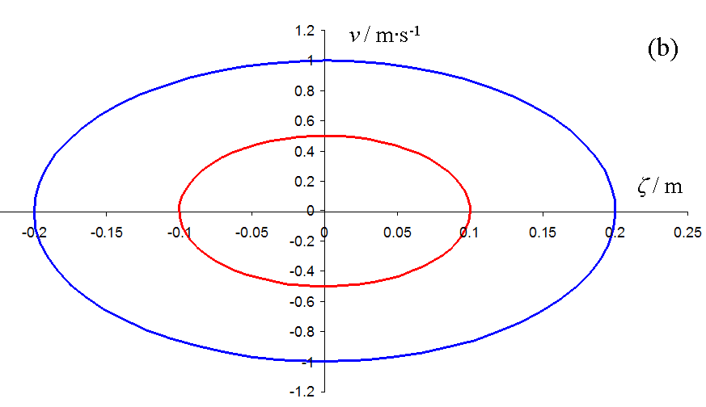
Classical states and phase space trajectories
In classical mechanics states with a particular energy are represented by a phase space trajectory;
Trajectories with all possible total energy values can be observed. The energy of trajectories can vary continuously.
p / kg·m·s⁻¹
F = -k(x-x₀)
U = k(x-x₀)²/2
ξ / m
(x-x₀) = ξ
For N atom classical systems, the state is represented by a 3N-dimensional point in phase space {r₁, p₁, r₂, p₂, …, r_{N}, p_{N}}
Each energy values defines a trajectory in phase space

Slide 14
Switching over from the classical to the quantum description of states
The quantum description of the state of an N-atom system in terms of a discrete set of states represented by a single quantum index i is much simpler than in terms of a continuous variation of the state {r₁, p₁, r₂, p₂, …, r_{N}, p_{N}} in phase space.
It is easier to do calculations of averages with discrete states
than with continuous states

Slide 15
The correspondence between quantum and classical states
The quantum description of the average of a function involves the sum over the discrete quantum states of an N-atom system
The classical description of an average of a function involves an integration over the 3N-dimensional phase space of the system
It can be proven that the exact correspondence between quantum states and volume in classical phase space is:
Number of quantum states ↔ Volume of phase space / h^{3N}
p
Δx
ΔpΔx = h corresponds on average to 1 quantum state
Δp
x

Slide 16
Classical limit to the canonical partition function
Sum over N particle quantum states
Semi-classical equivalent
Integral over phase space elements
h: minimum volume of phase space element from quantum mechanics
Molecules are indistinguishable
dpdq has units of energy·time (h Planck’s constant)

Slide 17
Classical limit to the canonical partition function
Hamiltonian of the system represents the energy in a canonical ensemble
Classical canonical partition function
We can separate the momentum and position integrals
Momentum integrals are Gaussian!

Slide 18
Hamiltonian of the system represents the energy in a canonical ensemble
Evaluating the momentum position integrals
Configurational integral
Regardless of the form of the potential energy function operating in the system, the contribution of the kinetic energy to the partition function is always the same.
All the complexity of the intramolecular and intermolecular forces are inherent in the configurational integral
If there are no interactions among the molecules in the system

Slide 19
Classical expression for probability in the canonical ensemble
The Hamiltonian always has the same form with respect to momentum
Substituting the Hamiltonian into the expression for probability and separating momenta from coordinates:
Classically momenta always follow the Maxwell distribution!!!
This is true for gases, liquids, and solids!

Slide 20
Classical expression for average energy in the canonical ensemble
Decompose into kinetic energy and potential energy contributions:
Each kinetic energy term gives the same contribution of kT/2

Slide 21
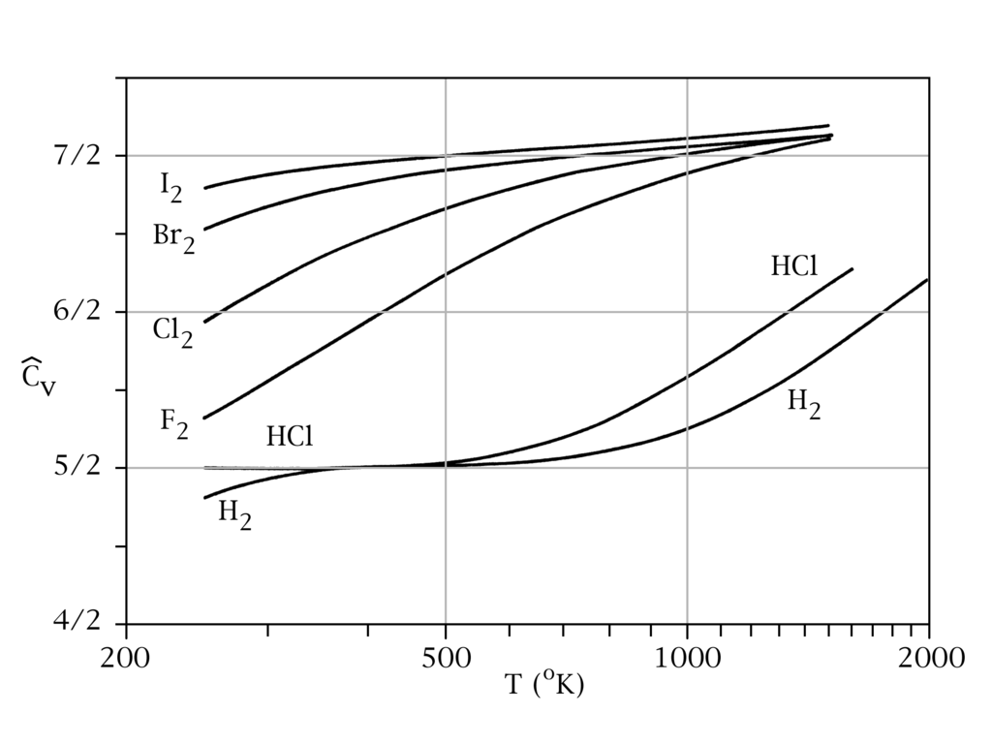
Classical equipartition principle
For Hamiltonians with quadratic terms
Predicts that each quadratic term contributes kT/2 to the average energy
Predicts that each quadratic term also contributes k/2 to the heat capacity (so heat capacities should be independent of temperature)
This predictions was found by measurements of heat capacity to be incorrect! (mid 1800’s)
Points to quantization of states

