Slide 1

Distribution of non-interacting molecules among quantum states
All molecules are binned by placing each according to its quantum state into a slot with its corresponding discrete energy
Bins for each state are labelled with the energy
N molecules
E total energy
ε₁
ε₂
ε₃
ε₄
ε₅
a₁
ε₆
ε_{j}
ε_{j+1}
∙∙∙
Quantum state energy ε₁ ε₂ ε₃ ε₄ ε₅ …
Occupancy of level a₁ a₂ a₃ a₄ a₅ …
The distribution of molecules among states must satisfy the constraints:
The total occupancies must equal the number of molecules
The total energy of system is fixed
How many ways can each binning (set of a_{j} values) be achieved?

Slide 2
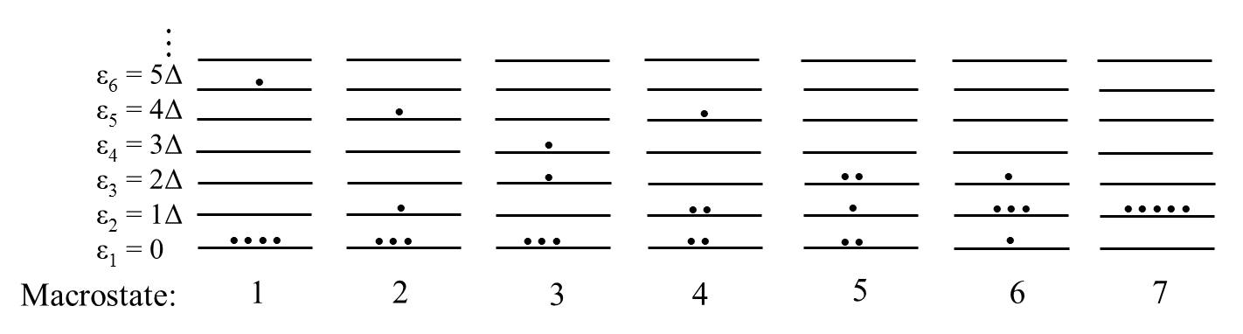
Example: Distributing distinguishable molecules among energy levels
…
ε₆ = 5Δ
ε₅ = 4Δ
ε₄ = 3Δ
ε₃ = 2Δ
ε₂ = 1Δ
ε₁ = 0
A system with equally spaced energy levels;
Find the distributions of 5 independent molecules among the energy levels satisfying two constraints:
The “macrostate”: E_{tot} = 5Δ
⟨ E ⟩ = Δ
•
•
Microstates
•
•
•
•
How many ways can each microstate be constructed (i.e., what is the degeneracy)?
5
20
20
30
30
20
1

Slide 3
Possible distributions satisfying the two constraints on the macrostate
Distributions (d_{i}) show how molecules occupy energy levels
a_{j} : Number of molecules that occupy energy level j in each distribution (occupancy of state j)
a₃=2
a₂=1
a₁=2
Distributions: {a₁, a₂, a₃, …, a₆} | Degeneracy (weight) of each distribution | Probability of each distribution P(d_{i})
d₁:{4,0,0,0,0,1} d₂:{3,1,0,0,1,0} d₃:{3,0,1,1,0,0} d₄:{2,2,0,1,0,0} d₅:{2,1,2,0,0,0} d₆:{1,3,1,0,0,0} d₇:{0,5,0,0,0,0} | W = 5!/[4!0!0!0!0!1!...] = 5 20 20 30 30 20 1 | 5/126 20/126 20/126 30/126 30/126 20/126 1/126
A total of 126 microstates of the molecules give the same macrostate
All 126 microstates are equally probable (law of equal a priori probabilities) but different distributions (macrostates), d_{i}, show up with different probability

Slide 4
Systems with large numbers of molecules
Macrostate
N = 7 and E_{tot} = 7Δ; ⟨E⟩ = Δ determine all possible distributions
Distributions: {a₁, a₂, a₃, …, a₈} | Degeneracy(weight) of each distribution | Probability of each distribution P(d_{i})
{6,0,0,0,0,0,0,1} {5,1,0,0,0,0,1,0} {5,0,1,0,0,1,0,0} {5,0,0,1,1,0,0,0} {4,2,0,0,0,1,0,0} {4,1,1,0,1,0,0,0} {4,1,0,2,0,0,0,0} {4,0,2,1,0,0,0,0} {3,3,0,0,1,0,0,0} {3,2,1,1,0,0,0,0} {3,1,3,0,0,0,0,0} {2,4,0,1,0,0,0,0} {2,3,2,0,0,0,0,0} {1,5,1,0,0,0,0,0} {0,7,0,0,0,0,0,0} | 7 42 42 42 105 210 105 105 140 420 140 105 210 42 1 | 7/1716 42/1716 42/1716 42/1716 105/1716 210/1716 105/1716 105/1716 140/1716 420/1716 140/1716 105/1716 210/1716 42/1716 1/1716
 | Total No. of microstates: 1716
•
•
•
•
•
…
ε₈ = 7Δ
ε₇ = 6Δ
ε₆ = 5Δ
ε₅ = 4Δ
ε₄ = 3Δ
ε₃ = 2Δ
ε₂ = 1Δ
ε₁ = 0
•
•
Most probable distribution

Slide 5
Finding the most probable distribution for systems with large numbers of molecules
The number of ways W(a) molecules can be distributed among energy levels increases greatly for large numbers of molecules and high energies
The most probable distribution {a*}, gives the greatest degeneracy W*({a}) and its probability dominants other macrostates as the number of molecules increases
How do we find the most probable distribution?
Maximize W(a) with respect to the occupancies, a_{i}, subject to the constraints on the system.
The volume dependence of the energy levels are shown explicitly
Some math
A function and its logarithm have the same maxima and minima
So we maximize ln[W(a)] instead of W(a). Why?

Slide 6
Finding the distribution with the maximum degeneracy (most probable distribution)
The lnW(a) can be evaluated using Stirling’s approximation for large integer N,
Giving:
Since we deal with large numbers of molecules (10²³) we can treat the occupancies as continuous variables.
Can we just calculate the derivative of lnW(a) with respect to the occupancy of a specific state i, a_{i} to determine the most probable distribution?
No! There are constraints on the a_{i’}s and they are not all independent

Slide 7
Method of Lagrange undetermined multipliers
The function for which we want to find the maximum
The constraint equations
The new function which includes the constraints
The maximum of the function subject to the constraints is determined by

Slide 8
Finding the most probable distribution subject to the constraints
Method of Lagrange underdetermined multipliers
Add the equations of the constraints to the function and then set the derivative to equal to 0 to find the maximum of the function
Constraints added with Lagrange multipliers α and β (to be later eliminated, see below)
Occupancy of state i in the most probable distribution
Applying the constraint on the occupancies allows elimination of α Lagrange multiplier:

Slide 9
Finding the most probable distribution subject to the constraints
Method of Lagrange underdetermined multipliers
Add the equations of the constraints to the function and then set the derivative to equal to 0 to find the maximum of the function
Constraints added with Lagrange multipliers α and β (to be later eliminated, see below)
Occupancy of state i in the most probable distribution
Applying the constraint on the occupancies allows elimination of α Lagrange multiplier:

Slide 10
Distribution with largest probability:
10
Probability of state i being occupied in the N molecule system in the most probable distribution
Partition function
(sum over states)
The exponential decay factor appears in the context of probability for system occupying state j.
ε₆
ε₅
L
ε₄
ε₃
ε₂
0
ε₁
L
Knowing probabilities of the different states, averages ⟨M⟩ of microscopic quantities M_{j} can be determined for the most probable distribution
We don’t know β. Note: no physics has been added to the analysis so far!
Notes:
10
CHM 4390 C / 8309

Slide 11
Probabilities for systems with interacting particles: The set-up
The system has a constant volume V with N interacting molecules;
The N-molecule interacting system as a whole is characterized by a quantum state i with energy E_{i};
There may be interactions between the molecules in the system, and these are all captured in the quantum states i;
The system has walls which allow it to exchange heat with its surroundings;
The temperature of the system is maintained constant.
Infinite bath (surroundings)
at temperature T
Heat exchange occurs between system and bath
System:
Volume V
Molecules N
Quantum states i

Slide 12
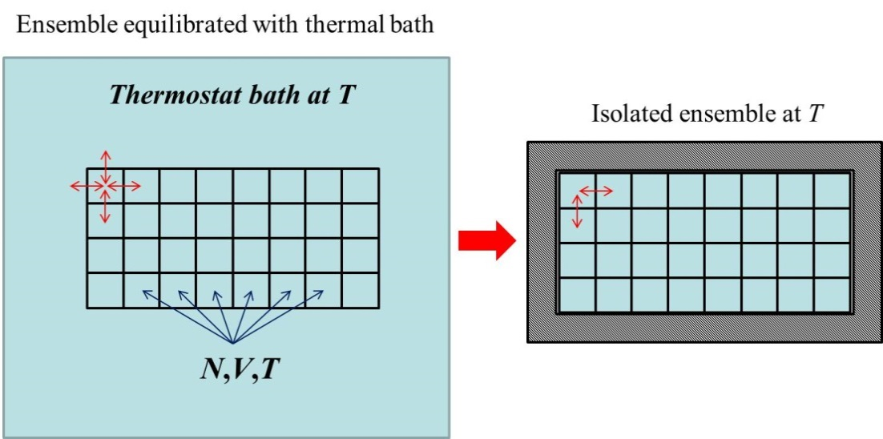
Probabilities for systems with interacting particles: The “canonical” ensemble
A large number of replicas of the system (the “ensemble”) are put in contact with each other and placed in the infinite heat bath. Heat exchange is possible between systems and bath;
The system replicas have constant volume and are maintained at constant temperature. This ensemble (collection) of systems is called the canonical ensemble;
A more descriptive name would be the “constant temperature – constant volume” (isothermal-isochoric, isothermal-isometric) ensemble;
After the ensemble equilibrates with the bath (environment), it is removed from contact with the bath and placed in an isolated container;
The replicas of the system in the system have a distribution of energies, E_{i}, from among possible quantum states
Isolated ensemble at fixed total energy
Ensemble of systems being equilibrated at a fixed temperature

Slide 13

Introducing the ensemble as a mathematical trick
The isolated ensemble is made of A → ∞ copies of the original system;
The total energy of the ensemble of systems is E → ∞;
E and A are mathematical constructs and do not have physical meaning.
The systems in the ensemble have quantized energies E_{i} consistent with nature of their interactions;
The number of systems in the ensemble in each energy state i are given as A_{i} (occupancy);
The distribution of systems in the ensemble among states must satisfy:
.
E₅
E₁
E₃
E₂₀
E₁
…

Slide 14
Analogy between non-interacting system and ensemble
Molecule states ε_{i}
Total system states E_{i}
ε₆
ε₅
E₇
E₅
E₁
E₃
E₂₀
E₁
E₆
E₅
ε₄
ε₃
ε₂
E₄
E₃
E₂
ε₁
…
E₁
The total gas system energy is distributed among the energies of the molecules:
The ensemble energy is distributed among the energies of the systems:
Energy can be distributed in different ways between molecules of the gas
Energy can be distributed in different ways between systems in the ensemble

Slide 15
Distribution of systems among energy levels
The ensemble of systems are binned by placing each system into a slot corresponding to its energy level
Make energy bins and label each with the system energy
A systems
E total energy
E₁
E₂
E₃
E₄
E₅
A₁
E₅
E₁
E₃
E₂₀
E₁
E₆
E_{j}
E_{j+1}
∙∙∙
…
Quantum energy level E₁ E₂ E₃ E₄ E₅ …
Occupancy of level A₁ A₂ A₃ A₄ A₅ …
The distribution of systems among energy levels must satisfy the constraints:
The total occupancies must equal the number of systems
The total energy of the ensemble is fixed

Slide 16
Finding the most probable distribution of systems in the ensemble
A particular distribution of members of the ensemble between system energy levels:
N-molecule quantum energy state: E₁ E₂ E₃ E₄ E₅ …
Occupancy of each energy state: A₁ A₂ A₃ A₄ A₅ …
Ways of assigning systems in the ensemble to different possible quantum states
Constraints
For a large ensemble (using Stirling’s approximation) :
Maximize lnW(A) with respect to the occupancy of each state A_{i} using Lagrange undetermined multipliers:

Slide 17
Most probable distribution of systems in the ensemble
Similar to the ideal gas system, the number of systems in the ensemble in state i in the most probable distribution, are:
Using the first constraint:
we eliminate the undetermined multiplier α,
Probability of observing a particular state i in most probable distribution
“Canonical” ensemble
(isothermal-isochoric ensemble)
partition function for system states
Averages of quantities can be calculated from knowledge of the probabilities
We still can’t use these relations since we do not know β

Slide 18
A reminder of a thermodynamic relation
Changes in energy of a system (1st Law of Thermodynamics):
Changes in the Helmholtz free energy of a system:
Maxwell’s equations
Taking the derivative of the energy equation with respect to volume:
Using the chain rule:
Thermodynamic equation of state:

Slide 19
Determining the β undetermined multiplier:
Connecting statistical mechanics with thermodynamic relations
Statistical mechanics relation for energy:
Statistical mechanics relation for pressure
After some steps (see appendix of Extended Lecture Notes)

Slide 20
Comparing statistical mechanics and thermodynamics relations
Thermodynamic relation:
Statistical mechanics relation:
Canonical ensemble partition function:
Energy of N-atom interacting system
(the Boltzmann factor!!!)
Relating thermodynamic quantities from the canonical ensemble partition function:
Instead of Q, we deal with the logarithm
Recall:

Slide 21
The partition function and thermodynamic quantities
The temperature derivative of lnQ gives:
The average energy is recognized in this relation:
Similarly, the volume derivative of lnQ gives:
Note that this relation is the statistical mechanical form for the equation of state!

Slide 22
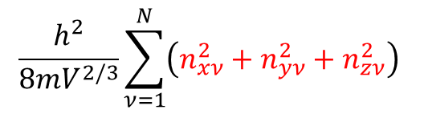
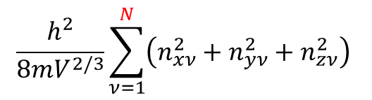
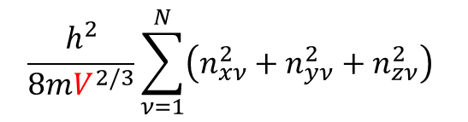
Ways to change the energy of a N-molecule ideal gas system
The energy is a function of the quantum state, the volume, and the number of ideal gas molecules in the system; E_{n}(N,V)
Change the distribution of molecules among the states
Change the volume V (which changes energy levels) without changing the distribution
Change the number of molecules in the system without changing the levels
$$\frac{h^{2}}{8mV^{2/3}}\sum_{ν=1}^{N}{\left(n_{xν}^{2}+n_{yν}^{2}+n_{zν}^{2}\right) }$$
$$\frac{h^{2}}{8mV^{2/3}}\sum_{ν=1}^{N}{\left(n_{xν}^{2}+n_{yν}^{2}+n_{zν}^{2}\right) }$$
$$\frac{h^{2}}{8mV^{2/3}}\sum_{ν=1}^{N}{\left(n_{xν}^{2}+n_{yν}^{2}+n_{zν}^{2}\right) }$$

