Slide 1
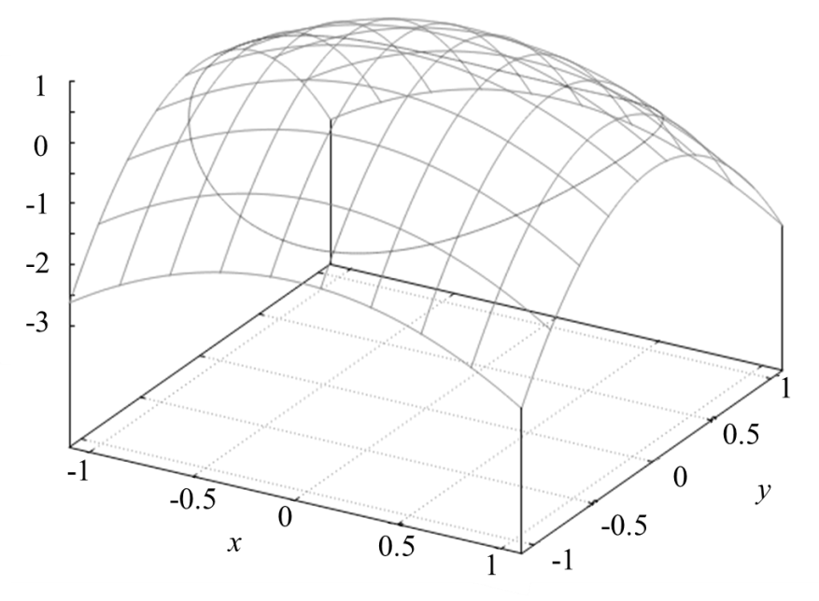
The Lagrange method of undetermined multipliers
We want to find the extremum (maximum or minimum) of a multi-variable function
Simultaneously find the extremum with respect to each separate variable
which gives the origin (0,0) as the maximum of the function
Formally, this is equivalent to finding the point where the gradient vector is zero

Slide 2
Contours of the surface projected onto the xy-plane
The contours represent curves of constant f(x,y) projected onto the xy-plane
The gradient vectors show the direction of the greatest slope at each point
The gradient vector is 0 at the maximum or minimum of the function

Slide 3
Finding the maximum of a function subject to a constraint
We want to find the maximum of a function that simultaneously satisfies a constraint on the values of x and y, represented by a function g(x,y)
The optimization procedure has to be modified.
Projection of constraint onto the surface f(x,y)
First solution: solve for y in the constraint equation and then substitute in f(x,y) and then optimize in terms of x.
Constraint on values of x and y

Slide 4
Method of Lagrange Multipliers
Gradient at a contour line
Gradient of the constraint
In general, at the points of intersection, the direction of the gradient of a contour line is not the same as the gradient of the curve representing the constraint.
If the gradient at a contour line is parallel to the gradient of the constraint, we have a maximum / minimum!
A scalar number
(value will be related to the constraint)

Slide 5
Method of Lagrange Multipliers
Define a new function Λ(x,y,λ) of the three variables in the condition of the constrained optimization,
All equations at the constraint are satisfied when:
This gives three equations for the variables:
Solutions:
(λ,x,y) = (-1,±1,0) and (-2,0,±1),
Check that the gradients are parallel at the solutions:

Slide 6
Method of Lagrange Multipliers
In a general case of a function f(x₁, x₂, …, x_{N}) subject to the α constraints g_{ν}(x₁, x₂, …, x_{N}) = 0 for ν = 1, 2, …, α,
the procedure is analogous.
Define a new function Λ(x,y,λ) of the three variables in the condition of the constrained optimization,
All equations at the constraint are satisfied when:
Solve the equations simultaneously to get the x₁, x₂, …, x_{N} and λ₁, λ₂, …, λ_{α} variables

