Slide 1
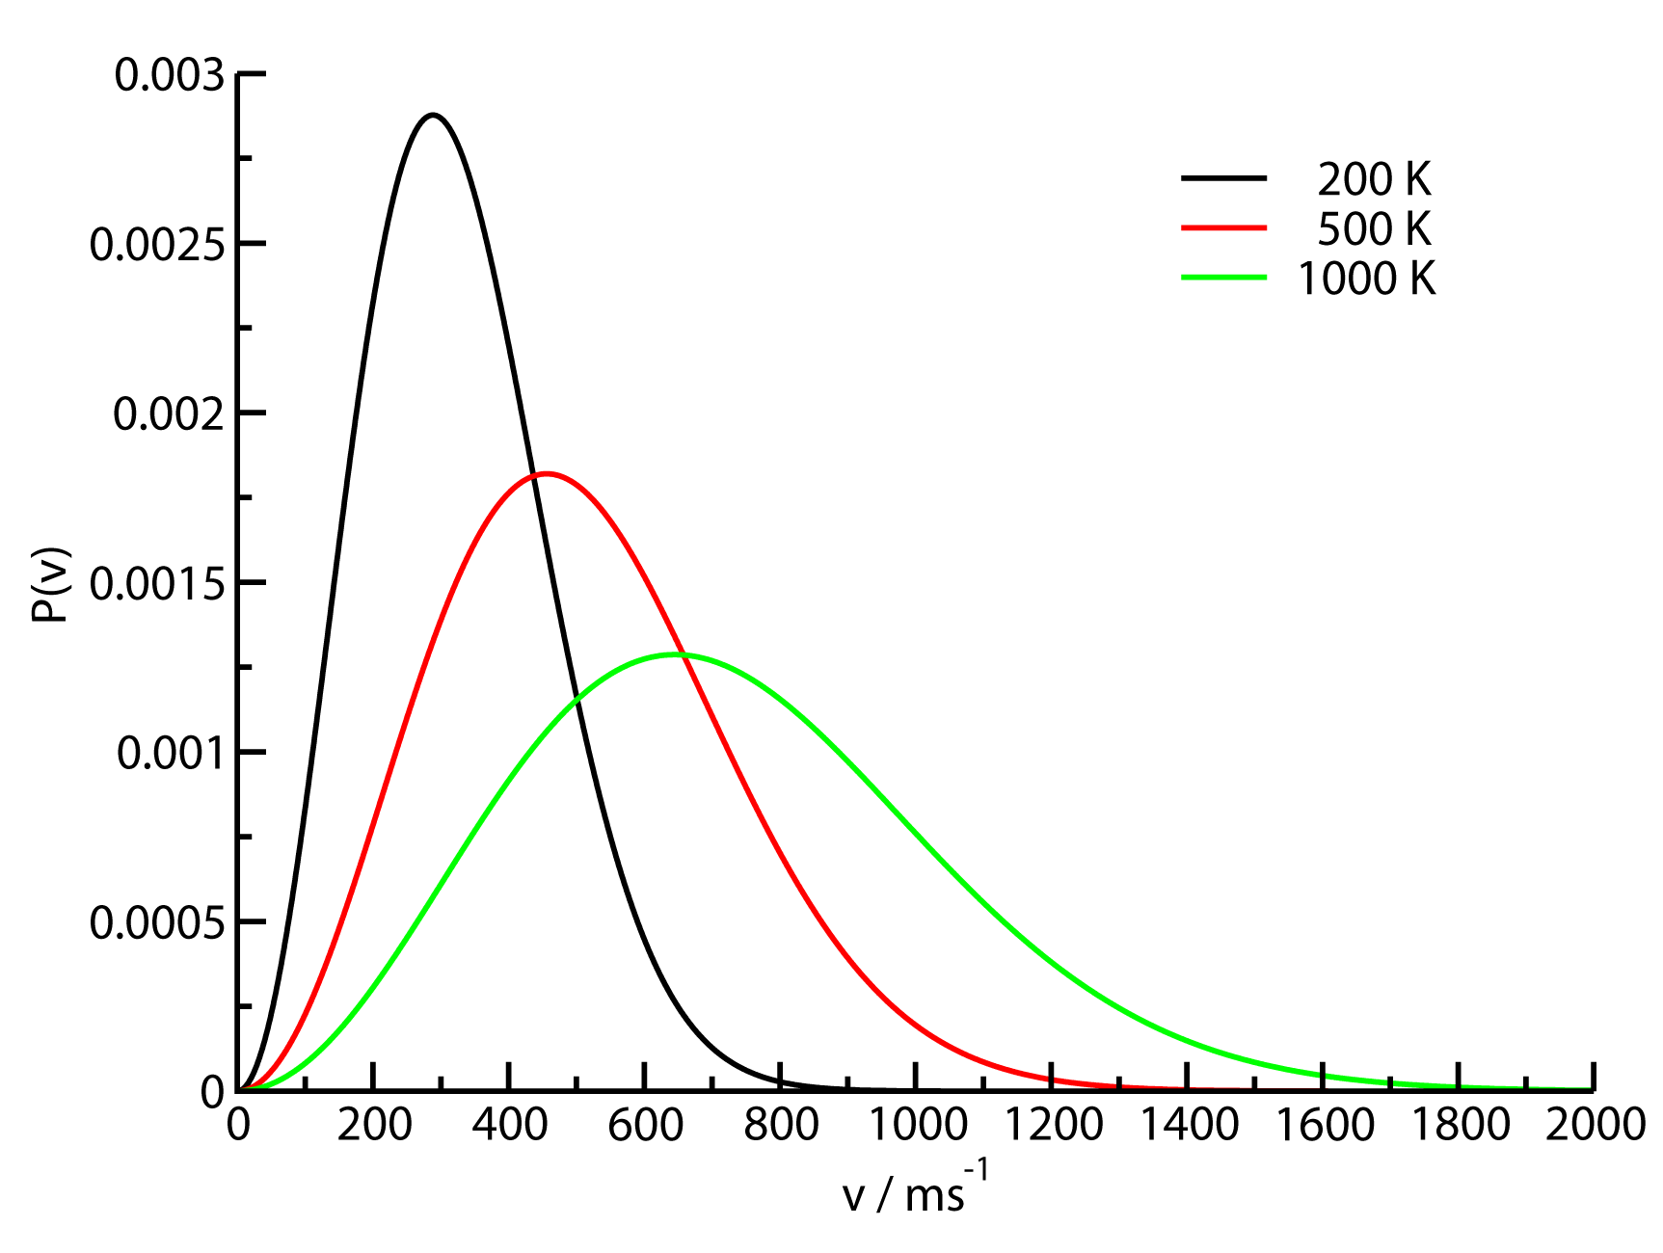
The Maxwell – Boltzmann distribution for speed of one molecule
The probability distribution for speed:
Most probable speed:
Average speed:
The probability distribution is broad!
Distribution becomes broader at higher temperature

Slide 2
Maxwell – Boltzmann distribution for single molecule energy
We can determine an energy distribution for a single ideal gas molecule by changing the variable from v to ε
Distribution function for the energy of one molecule:
Most probable energy
Average energy
Variance (spread) of the energy distribution?

Slide 3
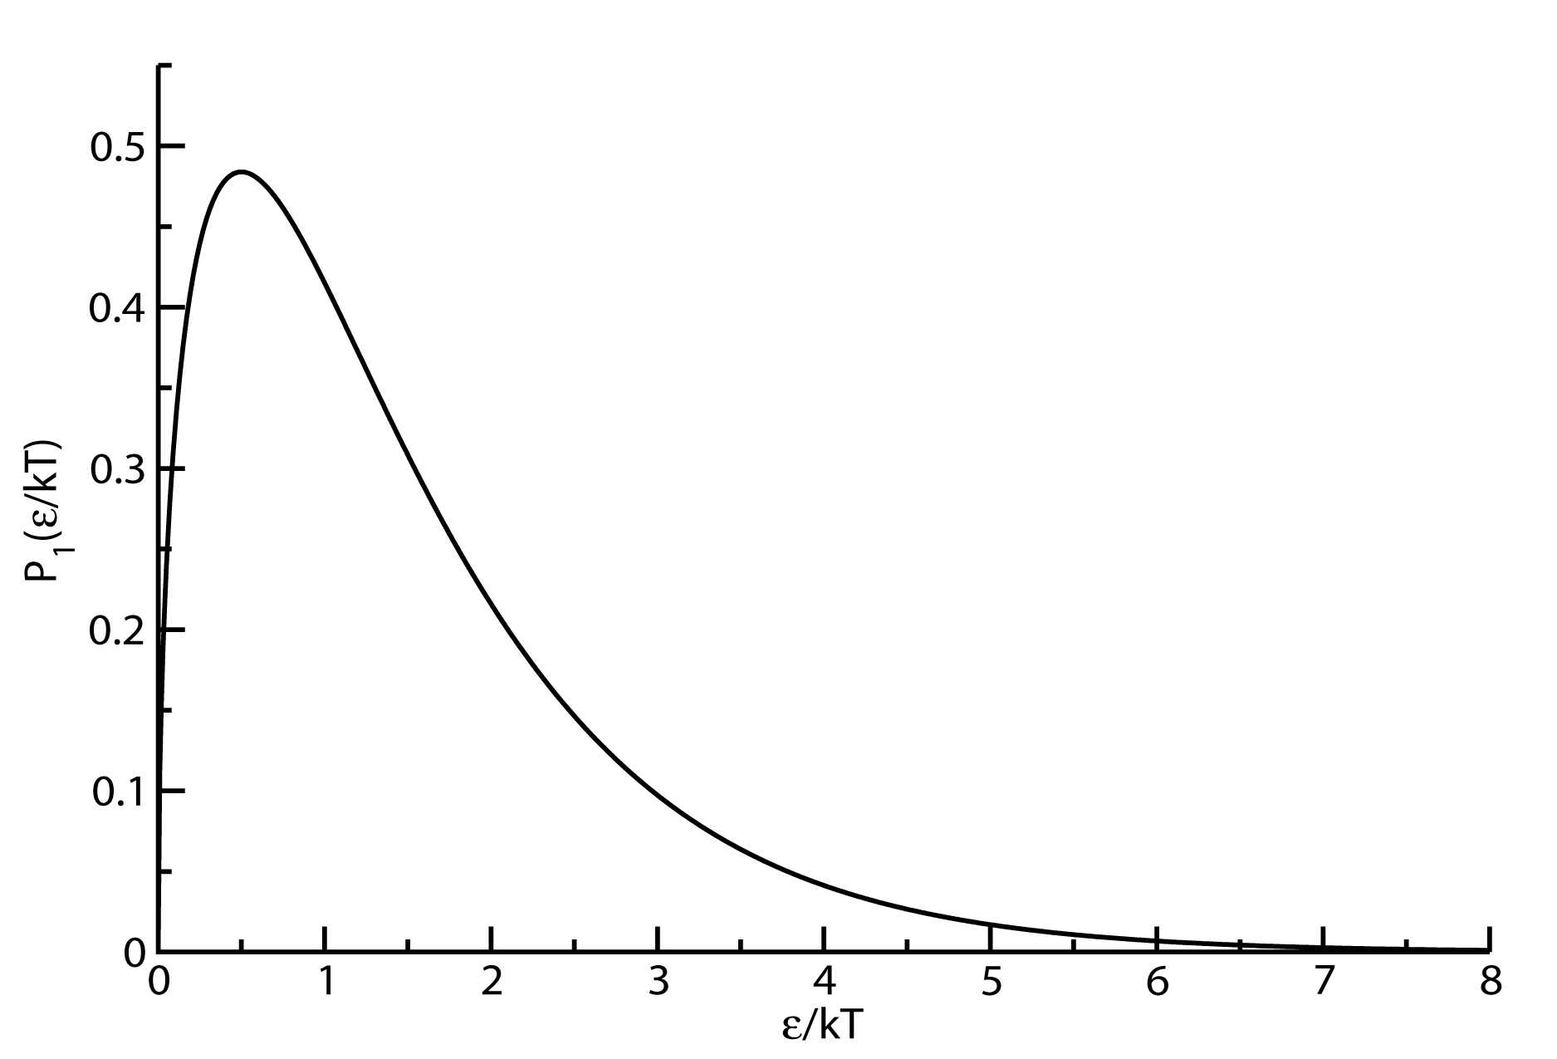
Maxwell – Boltzmann distribution for a single molecule energy
σ = (3/2)^{1/2}kT=1.22kT
The distribution of energy for a single ideal gas molecule is broad
3
Notes:
3
CHM 4390 C / 8309

Slide 4
Maxwell – Boltzmann distribution for total energy of two molecules
In an ideal gas, the total energy is the sum of one-molecule energies and the probabilities for energies in different molecules are uncorrelated
“Convolution” (or mixing) of two one-molecule energy probability distributions
The integral can be evaluated (see extended lecture notes) to give

Slide 5
Maxwell – Boltzmann distribution for energy of two molecules
Most probable two molecule energy:
Average:
Variance:
Recall:

Slide 6
Maxwell – Boltzmann distribution for energy of N-molecules
We can continue the convolution process to get probability for energies of N molecules:
Most probable:
Average:
Variance:
Change of variables to energy relative to the maximum E/E_{max} = E*

Slide 7
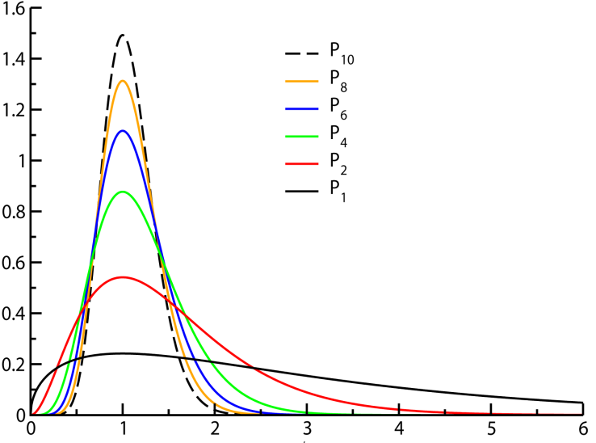
Maxwell – Boltzmann distribution for energy of N-molecules
E*=E/E_{max}
Probability distributions for 1 to 10 molecule energies
Probabilities get sharper as the number of molecules increases
The shape of the distribution becomes Gaussian (central limit theorem)!
P_{N}(E*)
E*

Slide 8
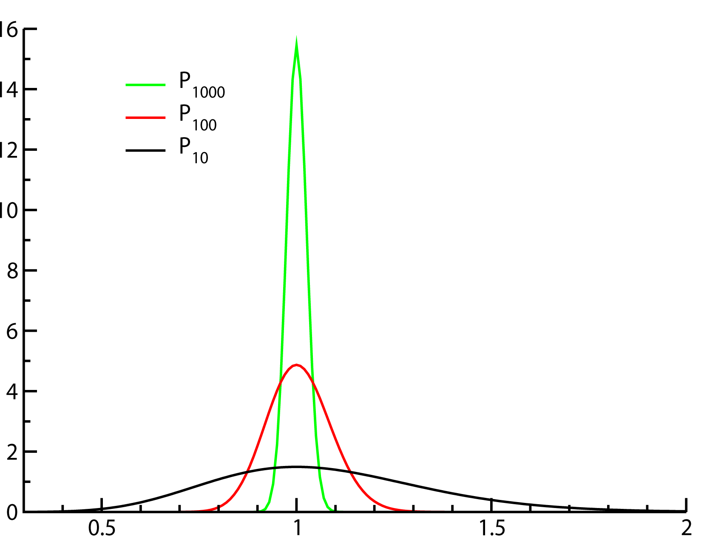
Energy distributions for large collections of molecules
Probability distributions for 10 to 1000 molecule energies
Stirling’s approximation can be used to evaluate factorials of large numbers:
Probabilities get sharp and narrow for large N
The most probable energy E_{max} overwhelms the distribution
P_{N}(E*)
E*

Slide 9
Central limit theorem applies for the energy distribution of for large collections of molecules
To simplify the analysis using n = 3N/2 – 1 and β = 1/kT we define:
x = (E_{N} – n/β)/(n/β)
The logarithm relation can be shown to give:
= 1 from the definition of the factorial of a large number (Stirling)
The energy distribution for the N molecule system becomes Gaussian:

