Slide 1
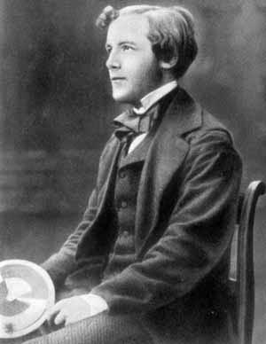


Maxwell – Boltzmann distribution for molecular velocities
James Clerk Maxwell
(1831-1879)
Ludwig Boltzmann
(1844 – 1906)
The velocity distribution is derived for an ideal gas based on very simple assumptions:
The distribution of velocity is isotropic in all directions (spatial homogeneity)
The velocity distributions in the x, y, and z directions are independent and identical
External factors enter into the distribution function for the velocity
We will derive the distribution function using statistical mechanics

Slide 2
Kinetic Theory of Gases: A Mechanistic Viewpoint of Gas Properties
Ideal Gas Model:
Atoms are small hard spheres which only interact upon collision
The volume of the atoms is much smaller than the volume of the gas
v : speed of the gas molecules
v_{x}, v_{y}, v_{z}: components of velocity
of the gas molecules
We assume no bias in the distribution of the velocity components v_{x}, v_{y}, v_{z}
Notes:
The result of the next three slides are needed in the Statistical Mechanics section and ca

Slide 3
Microscopic mechanical expression for pressure of an ideal gas
Force from molecule i on the wall is due to its collision with the wall and the resulting momentum change
L_{x}
≈
v_{x,i}
Change in momentum
i
W_{x2}
W_{x1}
Time between collisions
Pressure from molecule with velocity v_{x,i}
≈
x
Total gas pressure from all molecules in x-direction

Slide 4
Mechanical expression for pressure of an ideal gas - 2
From microscopic mechanical analysis
From experimental macroscopic study of ideal gases
Result: Temperature of a gas is related to the average kinetic energy of molecules!
A macroscopic thermodynamic variable T is related to the average value of the microscopic average kinetic energy in the system;
The average squared speed of molecules in the system is proportional to the temperature;
Can we find the probability distribution of speed and kinetic energy?

Slide 5
Assumption to get the Maxwell – Boltzmann distribution for velocities
1) Probabilities in x, y, z directions have identical mathematical form and are independent of each other.
2) The probability distribution only depends on the speed and not individual Cartesian components of the velocity, which are arbitrary (why?)
Combining 1) and 2)
Taking the derivative of both sides with respect to v_{x} (using the chain rule),
A Gaussian distribution!

Slide 6
Maxwell – Boltzmann distribution for molecular velocities
The probability distribution for the components have two unknown factors, A and C:
The A factor is determined by the normalization condition of the probability:
Note that the range of the velocity components is from -∞ to + ∞
The C factor is determined from the kinetic theory of gases result:
The probability distribution for Cartesian components
6
Notes:
6
CHM 4390 C / 8309

Slide 7
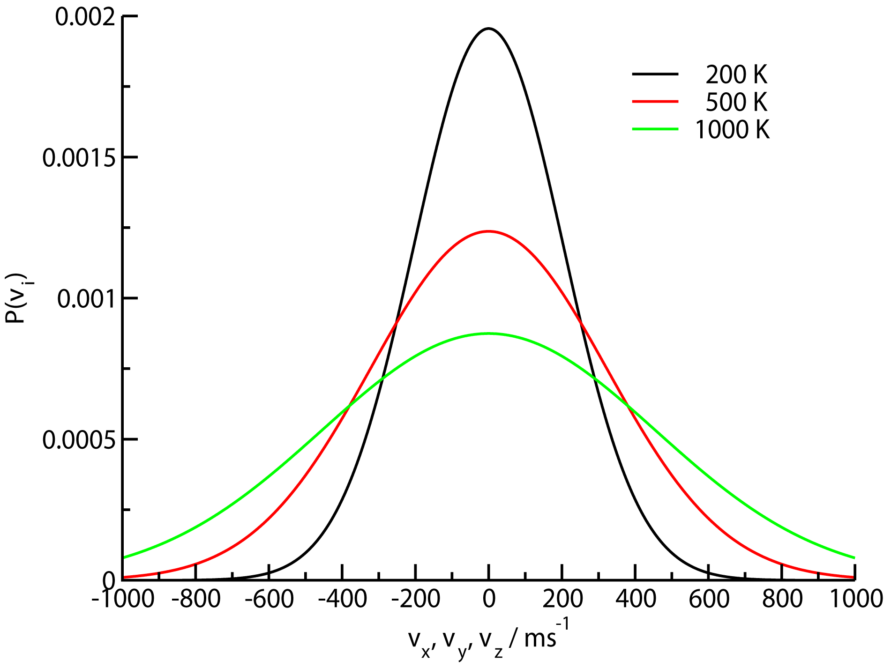
Maxwell – Boltzmann distribution for molecular velocities
https://phet.colorado.edu/en/simulation/gas-properties

Slide 8
Maxwell – Boltzmann distribution for molecular velocities
Distribution is symmetric w.r.t. positive and negative directions;
Average velocity component is 0;
Most probable value for the component of velocity is 0,
The standard deviation is:
Distribution is broad!
Distribution becomes broader at higher temperature

Slide 9
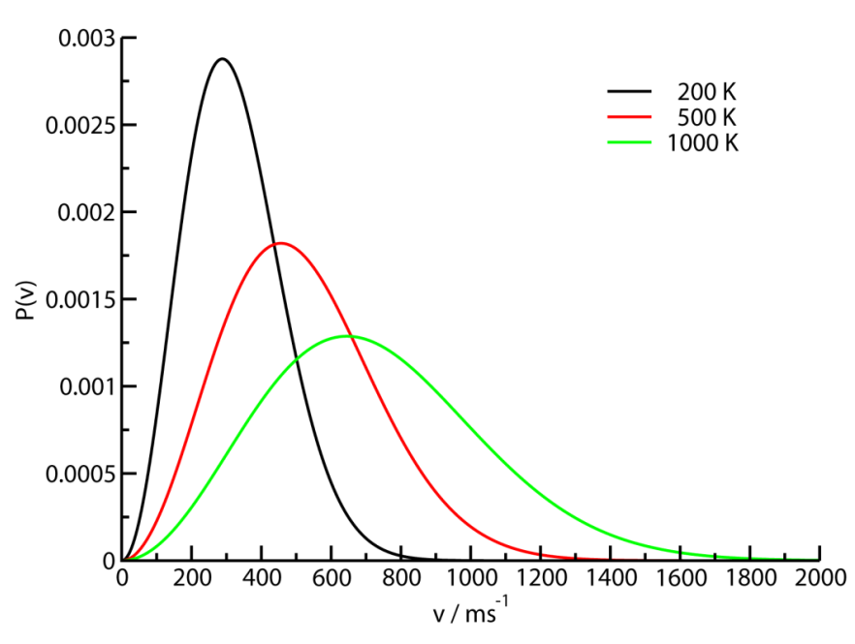
Maxwell – Boltzmann distribution for molecular speed
Combining the three components of the velocity distribution
Change the velocities from Cartesian coordinates to spherical polar coordinates:
Since the probability distribution does not depend on angles θ and φ, we integrate over them
To give a distribution function for speed:
The speed distribution is not Gaussian!

Slide 10

The Maxwell – Boltzmann distribution for speed of one molecule
The probability distribution for speed:
Most probable speed:
Average speed:
The probability distribution is broad!
Distribution becomes broader at higher temperature

Slide 11
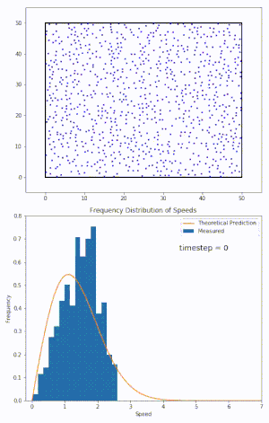
The Maxwell – Boltzmann distribution for speed of one molecule
Molecular dynamics simulation of ideal gas and determining the velocity distribution one molecule

