Slide 1
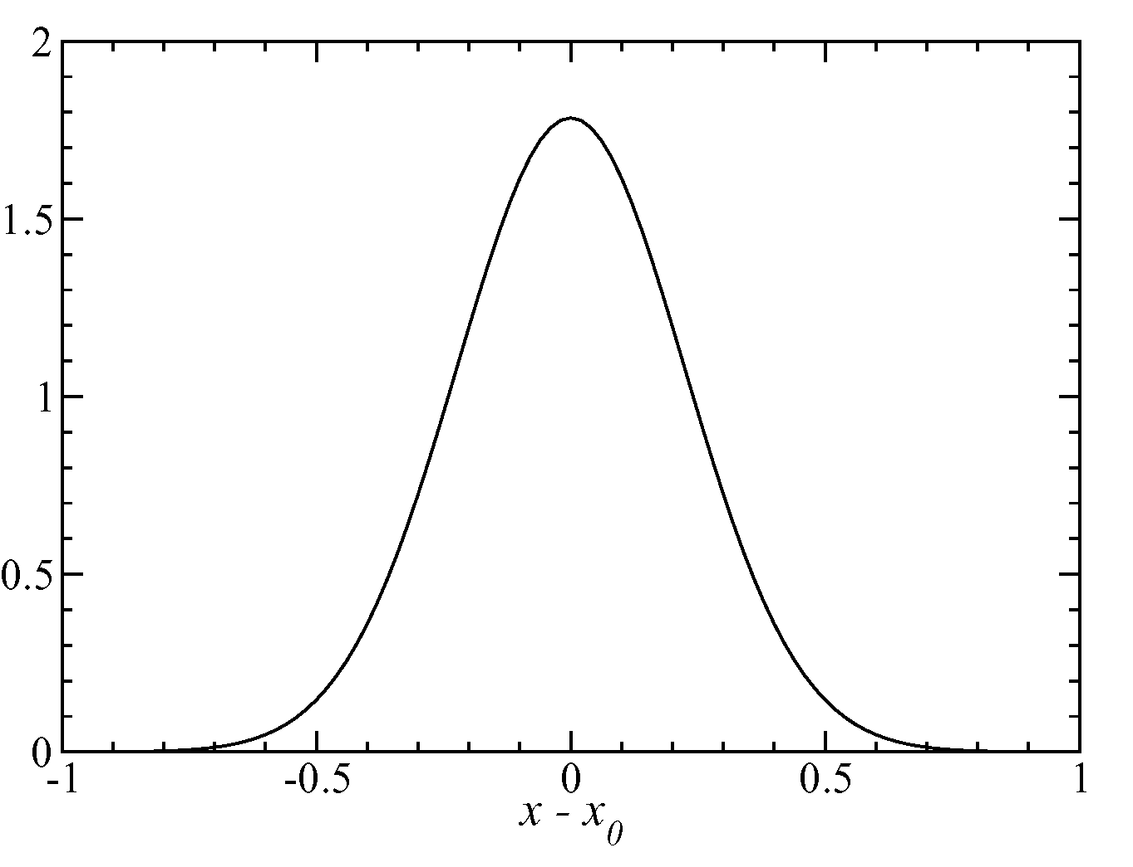

The Gaussian distribution
Probabilities are determined between a small range of the variable at a point x
P(x)
x + dx
x
P(x)dx = Probability of observing the variable between x and x + dx

Slide 2
Distributions functions of many independent variables
For a system with N variables x₁, x₂, …, x_{N} we can have collective variables X, which are a property of the entire system
P_{N}(X) is the probability distribution of collective variable X.
One of the simplest cases of a collective variable is the sum of the individual variables:
X = x₁ + x₂ + …+ x_{N}
X represents a “macrostate” or collective property of the system
The set of individual variables {x₁, x₂, …, x_{N}} associated with a particular X are called the “microstate”
If variables x₁, x₂, … x_{N} are independent and have the same distribution functions
The probability distribution for X = x₁ + x₂ + …+ x_{N} is
Note that different combinations of x₁, x₂, …, x_{N} can give the same X
Degeneracy

Slide 3
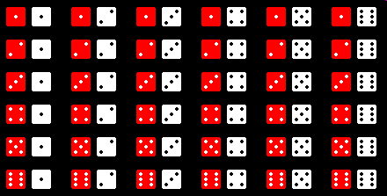
Two-variable distribution with independent variables
Role of two dice
Observed outcome variable is a sum:
E = ε _{I}+ ε _{II}
Observed probability is a product:
P₂(E)=∑ P₁(ε_{I})P₁(ε_{II})
The sum is over all ε _{I}+ ε _{II} which give
E = ε _{I}+ ε _{II}
Possible individual events, (ε_{I}, ε_{II}) (microstates) | Value of E=ε_{I}+ ε_{II} (macrostate) | Degeneracy of macrostate, Ω(E) | P₂(E)
(1,1) (1,2) (2,1) (1,3) (2,2) (3,1) (1,4) (2,3) (3,2) (4,1) (1,5) (2,4) (3,3) (4,2) (5,1) (1,6) (2,5) (3,4) (4,3) (5,2) (6,1) (2,6) (3,5) (4,4) (5,3) (6,2) (3,6) (4,5) (5,4) (6,3) (4,6) (5,5) (6,4) (5,6) (6,5) (6,6) | 2 3 4 5 6 7 8 9 10 11 12 | 1 2 3 4 5 6 5 4 3 2 1 | 1/36 2/36 3/36 4/36 5/36 6/36 5/36 4/36 3/36 2/36 1/36

Slide 4
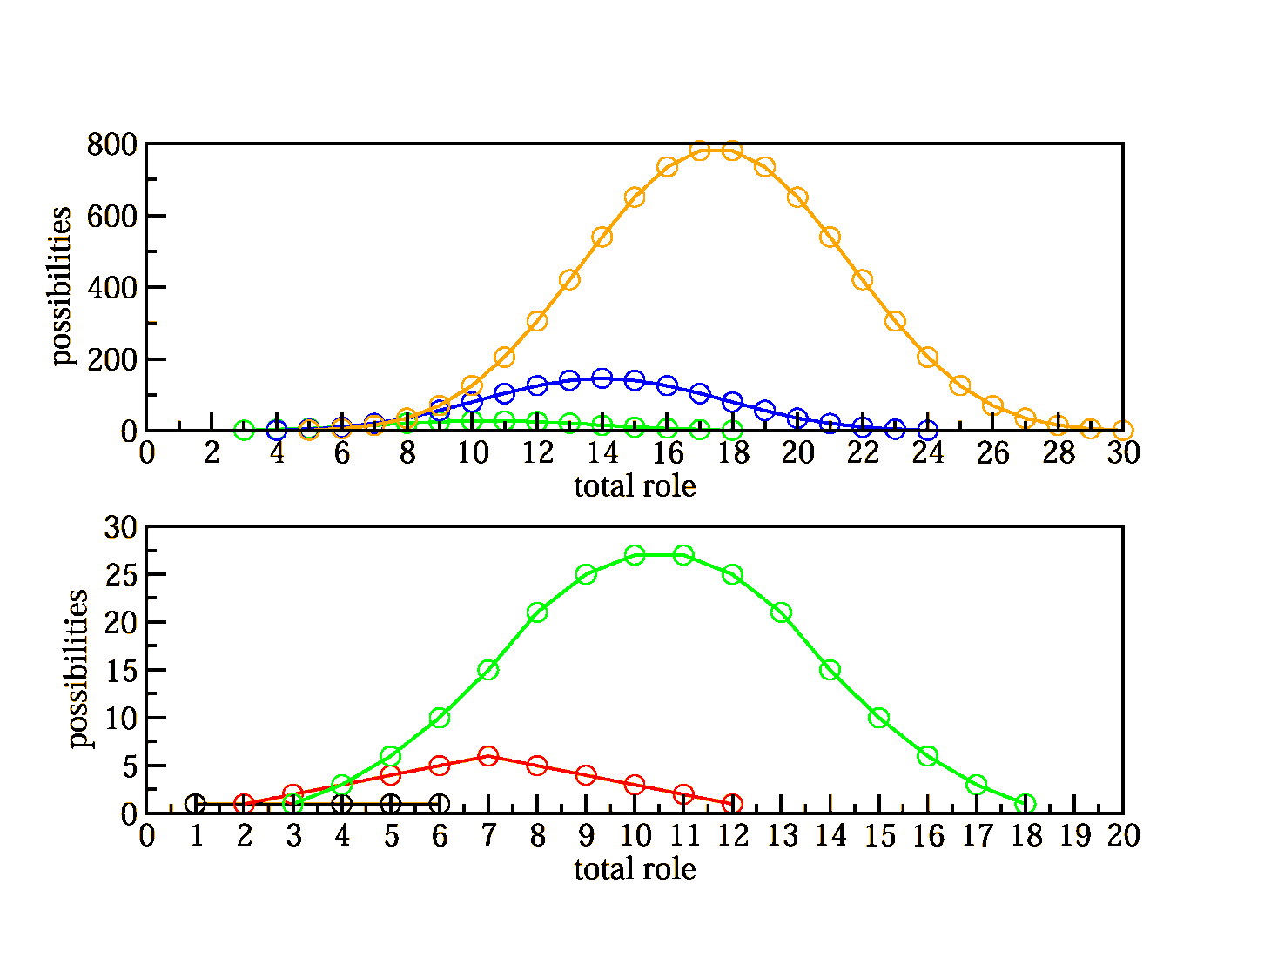
Multivariable distributions with independent stochastic variables
How does the behavior of the macrostate change with increasing numbers of variables?
Role of multiple dice
Three dice
Two dice
One die
P_{N}(X)
with
X = x_{I} + x_{II} + … + x_{N}
Un-normalized probability
Five dice
Four dice
Three dice
Note that the P_{N}(X) distributions start to look Gaussian, even though the P₁(x) are constant functions
4

Slide 5
Probability distributions with multiple independent stochastic variables
The independent stochastic variables x₁, x₂, … x_{N} have distribution functions
P₁(x₁), P₁(x₂), …, P₁(x_{N})
The N-variable probability distribution is
P_{N}(x₁,x₂,…x_{N}) = P₁(x₁)·P₁(x₂) ·…·P₁(x_{N})
This assumes the variables x₁, x₂, …, x_{N} are similar in nature and have the same mathematical form for their probability distribution, P₁(x_{i})
In many cases we are interested in the variable: X = x₁ + x₂ + … + x_{N}
-In addition to games of chance, this type of problem arises in molecular systems: What is the probability of the ideal gas system has an energy E
E_{N} = ε₁+ ε₂ + …+ ε_{N}
P_{N}(E)=∑ P₁(ε₁) P₁(ε₂)…P₁(ε_{N})

Slide 6
Probability distributions with multiple independent stochastic variables
1) The average of the sum X is the sum of the averages of the individual variables:
Exercise: prove
2) The variance in the sum X is the sum of the variances of the individual variables:
Exercise: prove

Slide 7
Properties of probability distributions for multivariable stochastic variables
If the distribution function for properties of individual variables (molecules) are identical:
The average of the compound system property X is the sum of the averages of one variable (molecule) properties
The variance of compound properties is the sum of the variance of one variable (molecule) properties
The spread of an N variable distribution relative to the mean becomes smaller as the number of variables increases!
7

Slide 8
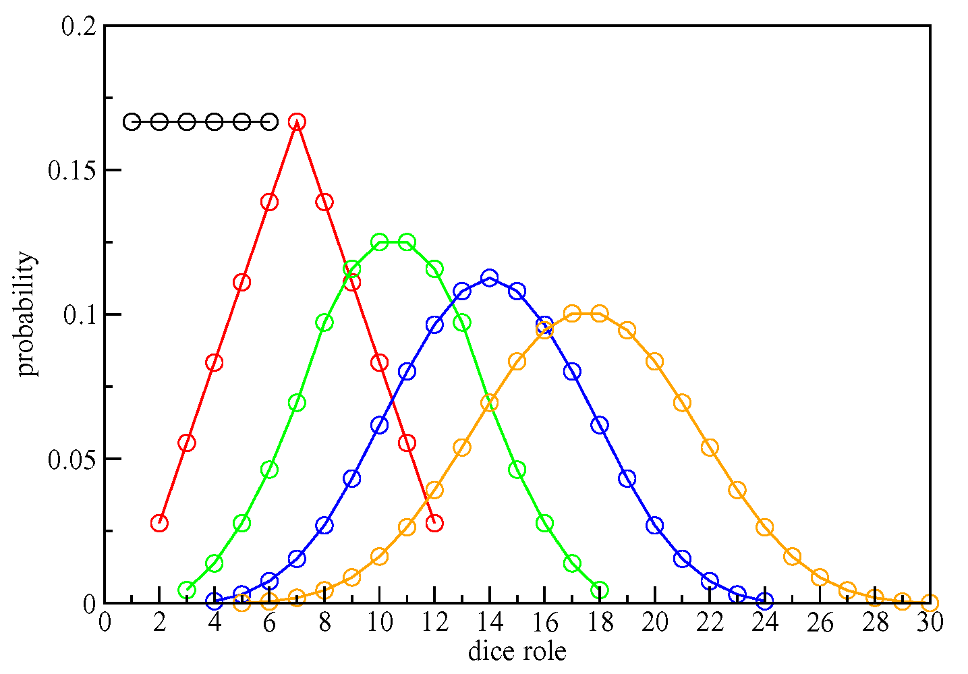
Central Limit Theorem: A general properties of probability distributions for multivariable stochastic variables
In the limit of large N, any reasonable multivariable distribution function P_{N}(X) for
X = x₁ + x₂ + … + x_{N}, becomes Gaussian!
Five dice
Four dice
Three dice
Two dice
One die

Slide 9
“Convolution”- How to determine multivariable distribution functions from one variable distribution functions
How do we determine the probability of getting a particular value of X from the role of the N dice?
For two dice, what is the probability of rolling a 4?
Formalizing this expression for rolling any value:
Prime shows we only include terms in the expansion where ε_{I} + ε_{II} = E
A similar expression for continuous variables:
Subscript shows limits on the range of the integrals so that always x_{I} + x_{II} = X

Slide 10
A shorthand representation of the constraint with a delta function:
The delta function allows us to eliminate the constraint on the limits of the integral:
Delta function eliminates integral over x_{II}:
Integral over x_{II} is non-zero only when
x_{II} = x_{I} + X
Final result for the convolution of independent variables:
See extended lecture notes for examples

