Slide 1
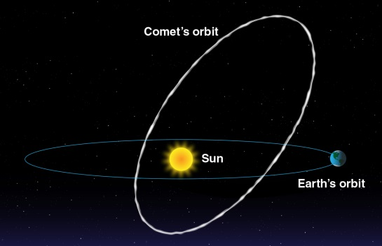
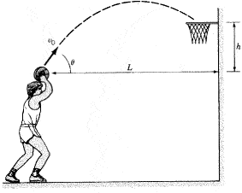


Probability theory
What predictions can we make about systems based on incomplete information?
Deterministic systems: Future behavior of the system (events) can be predicted with a required accuracy;
Classical mechanical systems with known initial conditions
Stochastic systems: Future behavior of the system (events) cannot be predicted with certainty;
Mechanical systems with incomplete knowledge of initial conditions (∆x, ∆v) or unknown external forces
Probability distributions are assigned to stochastic systems to represent as much information about the system as possible.

Slide 2
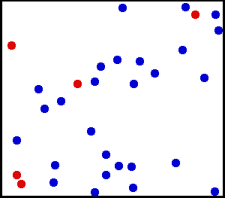
Probability theory for molecular systems
Molecular systems are deterministic! Two cases apply here:
1) The system is too complex so we cannot determine and/or keep track of all mechanical variables and their time dependence for all atoms in the system
2) In molecular dynamics simulations, we have the opposite problem of having too much information!
Wikipedia: Kinetic theory of gases
Simulations of other states of matter
To make global predictions about the bulk behavior of the system, do we need all the details of the motion of every single atom?
Are there average values of mechanical properties which capture the macroscopic behavior of the system?

Slide 3
Probability distributions for molecular systems
1) What form does the probability distribution take for molecular systems? How does it depend on positions, velocities, energies, … of the molecules?
2) Is there a unique probability distribution for molecular mechanical variables for each system?
3) How is the probability distribution affected by the interaction of the system with the environment?
T
Isolated system
System with thermostat
Statistical mechanics gives us a methodology for constructing probability distributions for the mechanical properties, without having to solve for all the microscopic mechanical variables.
What are the properties of probability distributions?
How do probability distribution behave for large numbers of variables?

Slide 4
Probability distributions for systems with discrete variables
The outcome of an event cannot be predicted with certainty
Total number of possible outcomes of the measurement are finite (ν)
The probability distribution represents our knowledge of the system:
Possible events (“event space”)
are assigned numbers
A probability is associated with each event
Conditions a probability distribution must satisfy:
For all events i assigned probabilities are positive: P(i) ≥ 0
The sum of the probabilities add up to 1

Slide 5

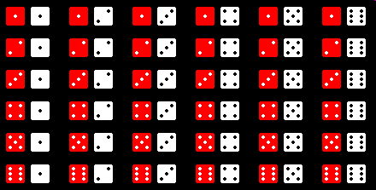

Examples of probability distributions for systems with discrete variables
Physical events ε_{i} are assigned probabilities P(i) which reflect their nature as much as possible. The events are also assigned numbers.
Role of one die
Flipping coins
ε_{i}
P(i)
ε_{i} 0 1
Rolling two dice
P(i)
Poker
E_{i} 1 2 3 … 36
P₂(i)
5

Slide 6
Characterizing a probability distribution with discrete variables
Event
ε_{i}
Probability
P(i)
How can we characterize the distribution?
Measures” of the distribution:
Average or expectation value for a distribution
Note: The average of the distribution does not have to correspond to an event

Slide 7
Characterizing probability distributions
2nd moment of the distribution for the throw of one die
Note:
2nd central moment (variance)
The standard deviation characterizes the width of a distribution

Slide 8
Characterizing probability distributions
In general, other characterization of the distribution are available
The m^{th} moment of a distribution
The m^{th} central moment of a distribution
The average of any mathematical function of ε_{i} for the distribution:

Slide 9
Probability distributions with continuous variables
Some stochastic variables (events) can take continuous values within a range [x_{min}, x_{max}]
ε_{i} → x
An infinite number of x values are possible in the range
x
x_{min}
x_{max}
Common ranges for variables:
0 ↔ 1
0 ↔ +∞
−∞ ↔ +∞
There are an infinite number of points on the real number axis, so the probability of getting an exact value x from a measurement is mathematically 0.
Probability of observing the event between x and x+dx is given as P(x)dx where P(x) is the probability distribution for a continuous variable,
Properties of the probability distribution p(x) for a continuous variable:
1) All probabilities are positive
For all x : P(x) ≥ 0
2) The probability is normalized

Slide 10
Characterizing continuous probability distributions
Average or expectation value for a distribution
The 2nd moment of the distribution is
The 2^{ne} central moment or variance of the distribution
The standard deviation of the distribution

Slide 11
Characterizing continuous probability distributions
The m^{th} moment of the distribution
The m^{th} central moment of the distribution
The average of any function f(x) of x can be calculated for the distribution

Slide 12
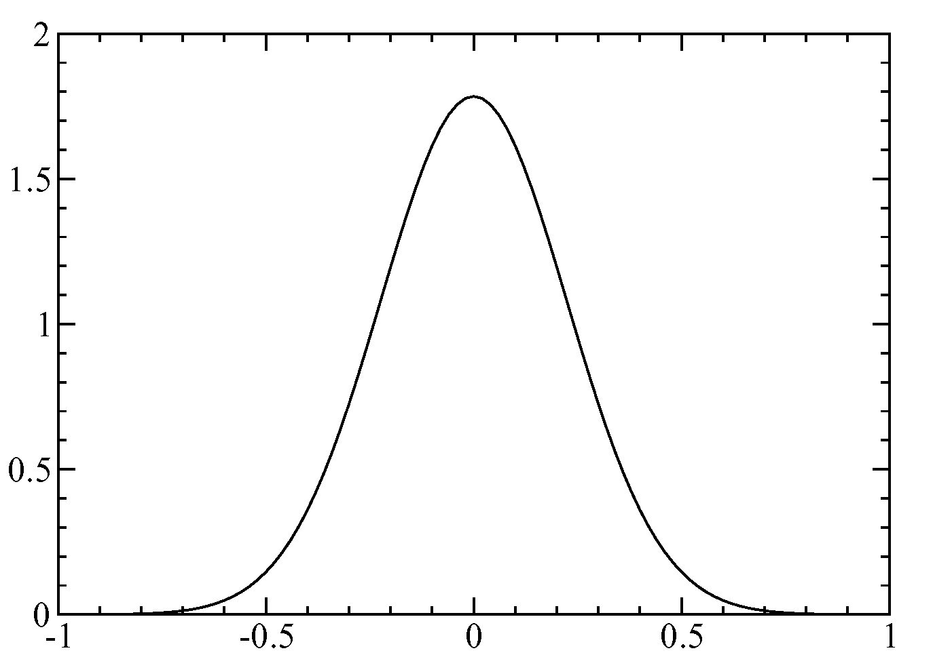
The Gaussian distribution: a widely used continuous distribution function
width of the distribution
The Gaussian distribution is normalized
x at maximum of the distribution
P(x)
x – x₀

Slide 13
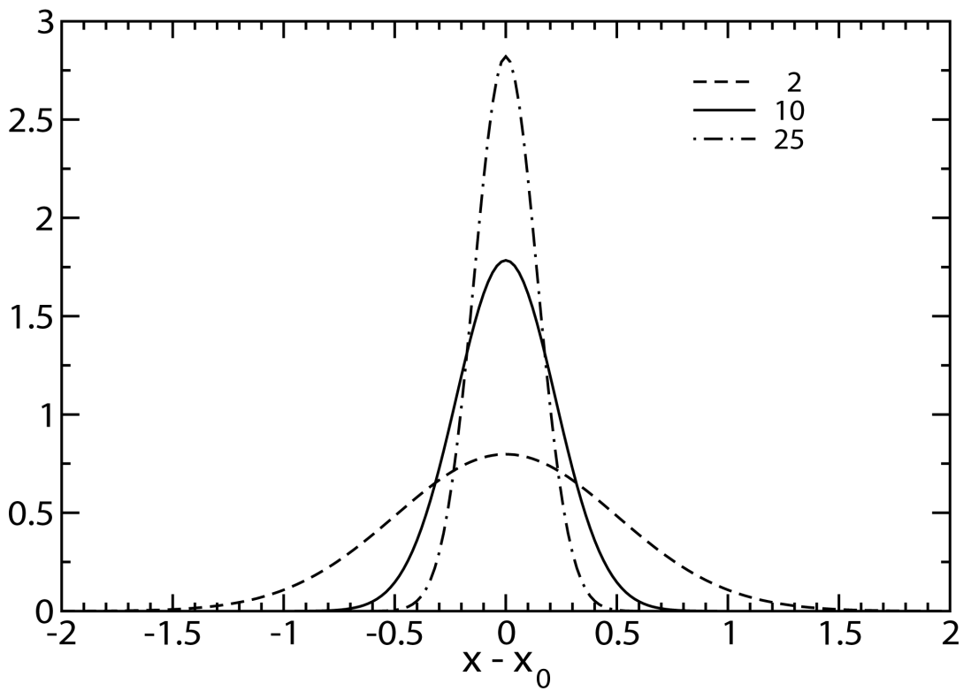
The Gaussian (“normal”) distribution function
α
P(x)
Considered the “natural” or “normal” distribution function when no other information is known about the distribution of the variables
Average of a Gaussian distribution:
Variance of a Gaussian distribution:
Note: the three distributions above have the same average, but not the same variance
See Appendix of Extended Lecture Notes for integrals

