Slide 1
Quantum mechanical treatment of simple systems:
The time-independent Schrödinger equation
Time-independent Schrödinger equation give allowed stationary wave-like quantum states in a system. For a one-particle, three dimensional system:
States characterized by the wave function are obtained
Only discrete energies are allowed
The time-independent Schrödinger equation is a “wave equation” which gives all possible stable (stationary waves) for a given system
Based on the de Broglie idea that matter can be described by particles and waves, the same way as light

Slide 2
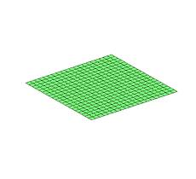
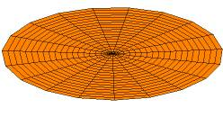
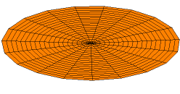
Classical wave equation
Drum skin with stationary boundary conditions
Square membrane with stationary boundary conditions
String confined between two stationary points
The Schrödinger equation is also a wave equation
In quantum mechanics, the “state” is represented by a wave function
The wave function gives the probability of observing the particle at a certain location with a specific momentum
The energy of the states are quantized. Not all possible energy values are observed

Slide 3
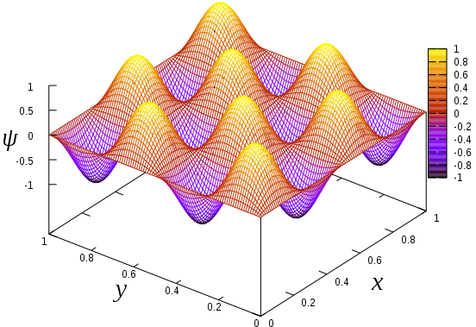
Quantum mechanical particle in a box (ideal gas) system
Potential energy for particle in a three-dimensional cubic box model:
L
0
L
Wave function of particle in a three-dimensional cubic box:
Quantized energy levels of particle in a three-dimensional cubic box:
-For light particles and small confinement volumes, the gaps between energy levels for different combinations of n_{i} are large (quantum dots)
- For large volume (a typical gas), the energy levels are very closely spaced

Slide 4
Degeneracy of states of molecules in a 3-dimensional cubic box
Consider the following three states:
They all have an energy of:
Degeneracy: Three microstates have the same energy
Two non-interacting particles in a three-dimensional cubic box have higher degeneracy:
Six degenerate microstates:
(2,1,1,1,1,1) (1,2,1,1,1,1) (1,1,2,1,1,1)
(1,1,1,2,1,1) (1,1,1,1,2,1) (1,1,1,1,1,2)

Slide 5
Discrete states for the quantum mechanical harmonic oscillator
The potential energy function for the harmonic oscillator is used in the Schrödinger equation.
The energy of the quantum mechanical harmonic oscillator are quantized. Only certain energy values are allowed.
Energy
The quantum index or quantum number
Further reading
The “state” of the system is represented by a single discrete quantum index i.

Slide 6
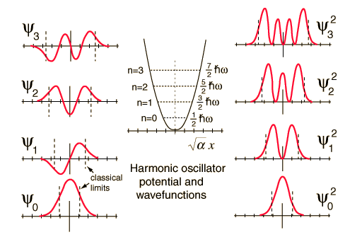
Discrete states for the quantum mechanical harmonic oscillator
The wavefunction does not give the exact position and momentum of the object, but rather a probability of observing the object in certain locations
Hermite polynomials
Exact knowledge of the position and momentum of the object is not available in the quantum mechanical system. The best we can do is to predict these quantities within a minimum uncertainty.

Slide 7
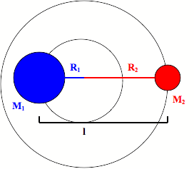
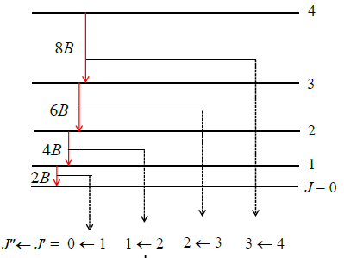
Discrete states for the quantum mechanical “rigid rotor”
Solving the Schrödinger equation for the rotation of a rigid linear molecule;
The rotation is represented by angular variables θ (polar angle) and ϕ (azimuth);
The energy of the rotational states are quantized.
The energies of the quantum mechanical rigid rotor are quantized.
Rotational quantum number
The rotational energy states have a degeneracy of 2J + 1.

Slide 8
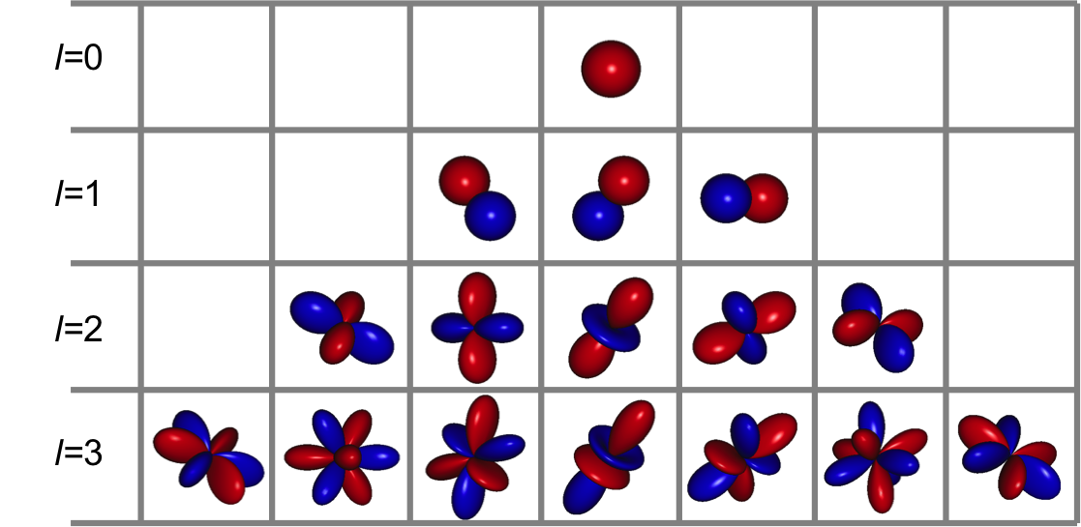
Discrete states for the quantum mechanical rigid rotor
The wave functions for the rigid rotor are the spherical harmonics Y_{J,m}(θ,ϕ)
Spherical harmonics
The rigid rotor wave functions with:
l = even are symmetric with respect to inversion around the molecule center
l = odd are antisymmetric with respect to inversion about the molecule center
Important when applying the Pauli exclusion principle to molecular wave functions

Slide 9
N-molecule states in quantum mechanics
For the three-dimensional system of N atoms, the Schrödinger equation is:
The wave function ψ_{n}({r}) is a function of coordinates:
{x₁, y₁, z₁, x₂, y₂, z₂, …, x_{N}, y_{N}, z_{N}}.
For an N-atom quantum system, the state of the system is represented by a discrete quantum index n. The index is a compound of all 3N dimensions in the system
The state n has a corresponding energy E_{n}
Even though we may not be able to determine the form of the state n and the E_{n}, we can characterize a complex system with discrete states

