Slide 1
A Quick Review Simple Mechanical Systems and Phase Space
Newton’s equations of motion are written as differential equations in Cartesian coordinates which are specified with knowledge of the force
Potential energy of the particle
Total force on particle depends on the position of the particle at time t: {x(t)}.
In vectorial form:

Slide 2
One-dimensional motion under constant gravitational force
Newton’s second law for a mass m moving in a constant gravitation force F_{y} = mg:
Initial conditions: At t = 0
y = y(0) & v_{y} = v_{y}(0)
Solution (by integrating twice):
v_{y}(0)
y(0)
Mechanical energy of the system at any time

Slide 3
One-dimensional motion under constant gravitational force:
Trajectory of the motion
In terms of momentum p_{y}=mv_{y} instead of speed

Slide 4
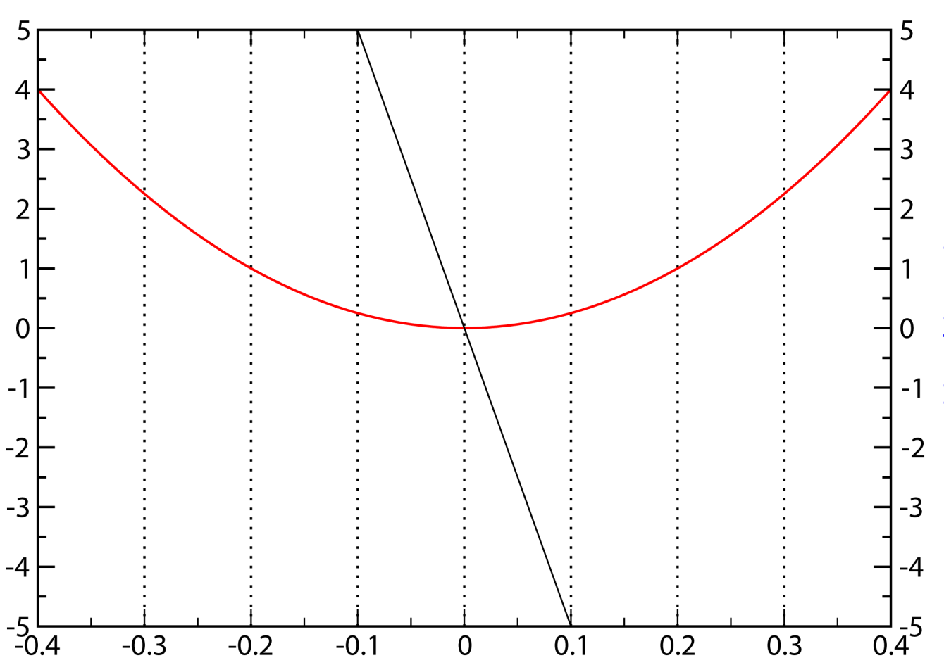
One-dimensional motion under position-dependent forces: Harmonic oscillator
Hooke’s law
Force always opposes the displacement
Potential energy is symmetric with respect to compression and expansion
x₀
U = k(x-x₀)²/2
F = -k(x-x₀)
ξ = (x-x₀) [displacement]

Slide 5
One-dimensional motion under position-dependent forces: Harmonic oscillator
Newton’s second law
change variable to
displacement ξ
x(0) = x₀
v(0)
t = 0
Initial state
x_{max;}
v = 0
t₁
x₀
-v(0)
t₂
−x_{max}
v = 0
t₃
x
−x_{max}
x₀
x_{max}

Slide 6
One-dimensional harmonic oscillator: Analytical solution
Combine variables to get the angular frequency
The general solution of this equation: (check by substitution)
Amplitude
Phase
Frequency of motion
Period of motion

Slide 7
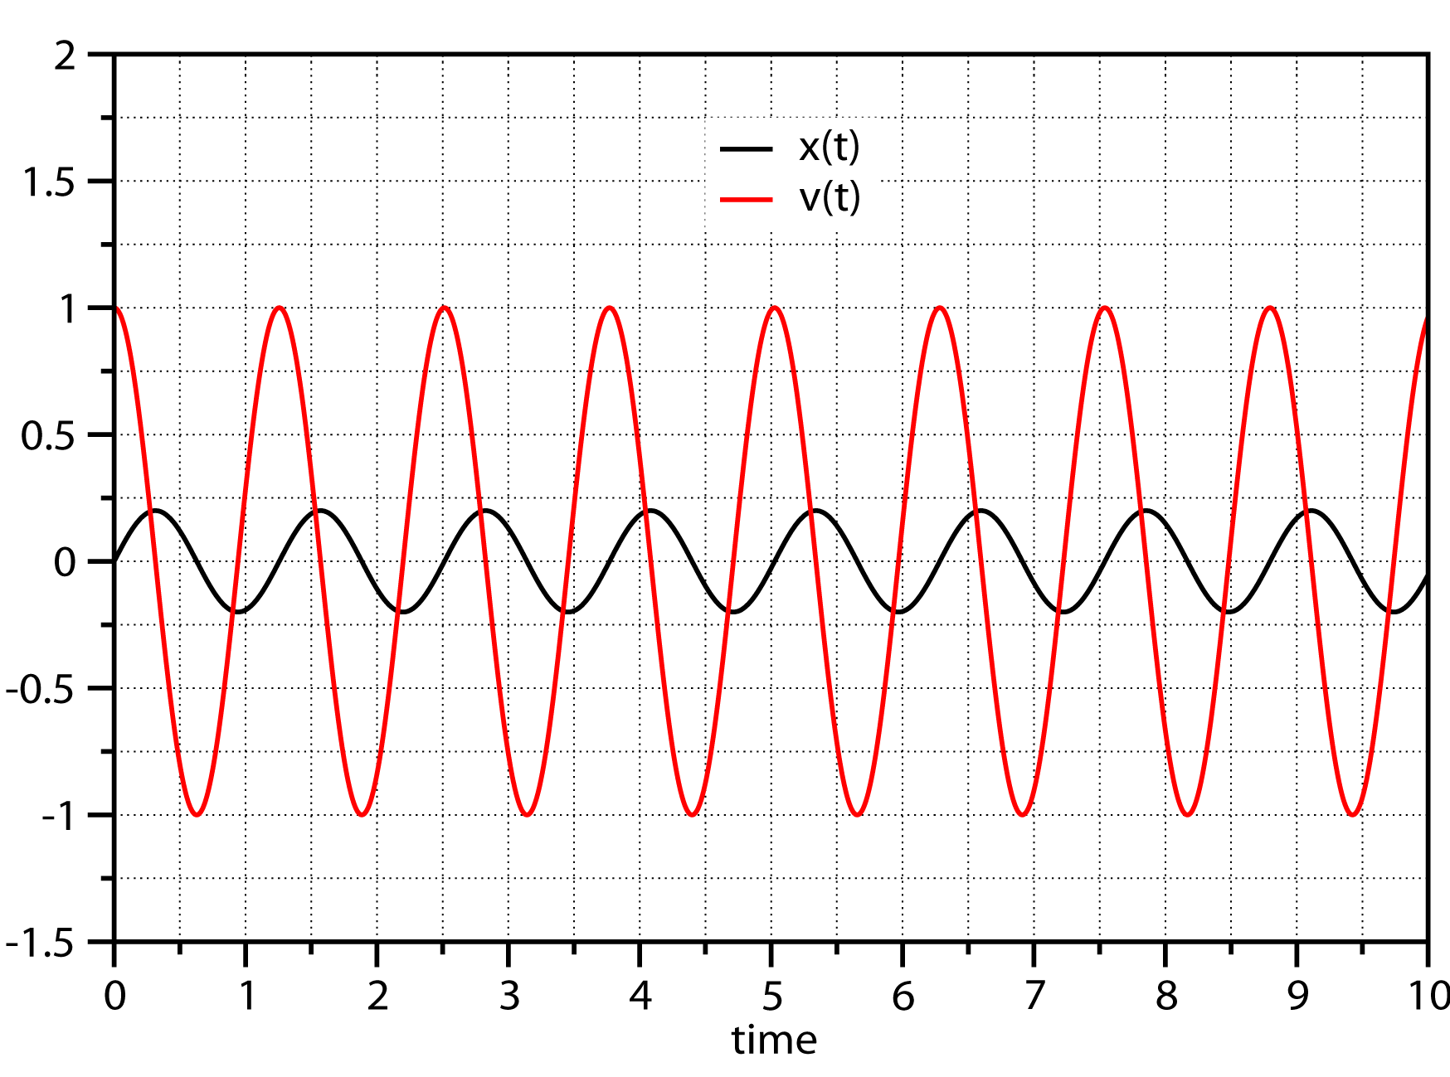
The specific solution depends on initial conditions
General solution
Initial conditions
ω = 5.0 s⁻¹
Specific solution
ξ(0) = 0.0 m
v_{ξ}(0) = 1.0 m/s
ξ(t)
v(t)
v_{ξ}(t)
ξ(t)
Energy of the harmonic oscillator is determined by the initial conditions

Slide 8
Molecular motion: Diatomic molecules
Consider to atoms 1 and 2 interacting with some force which is just a function of the distance between the two atoms, F(|r₁-r₂|) = F(r)
y
r
r₁
r₂
R_{cm}
x
We define the center of mass position, R_{cm}, and relative coordinates, r, as,
In terms of these coordinates, the position vectors of the two particles can therefore be written as,
The second time derivatives of r₁ and r₂ can be written in terms of time derivatives of R_{cm} and r

Slide 9
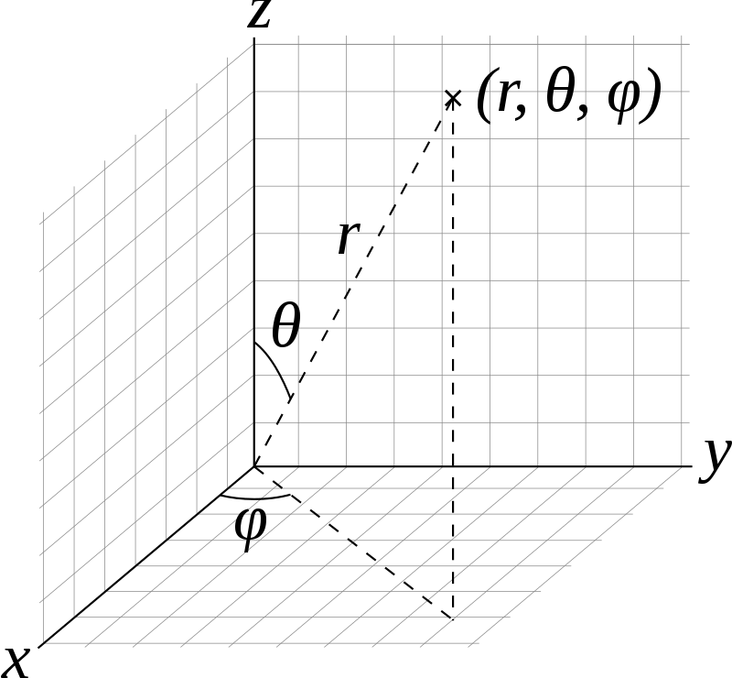
Molecular motion: Diatomic molecules, separating motions
Substituting into the equations motion gives two new equations for the center of mass and relative motion:
In the new coordinate system,
Motion of the center of mass and relative coordinates are not coupled
The center of mass of the two atoms moves as a free particle subject to no force
The relative motion is described by a particle of mass μ₁₂ moving under a force F(r).
Rather than Cartesian coordinates r ≡ {x, y, z}, the relative motion is described in the polar coordinate system
Showing time derivatives with the “dot” notation introduced by Newton:

Slide 10
Molecular motion: Diatomic molecules, separating motions
The total energy for the two atom system is
The total energy in the center of mass and relative position frame becomes
Changing the relative position to polar coordinates allows separation of vibrational motion (involving changing r) and rotational motion (involving change of θ and ϕ)
The energy is broken down to independent contributions from translation of the “molecule” as a whole, and “intramolecular” rotations and vibrations.
A procedure more complex, but similar in spirit, can be carried out to show that for polyatomic molecules the mechanical energy of the system can be separated into a translational motion of the center of mass, and rotational, and vibrational intermolecular motions

Slide 11
The Lagrangian approach to classical mechanics
We define the Lagrangian in terms of coordinates, r, and conjugate velocities,
$$v=\dot{r}$$
In the Lagrangian approach, velocity is an independent variable
Force is eliminated in favor of potential energy
The Euler – Lagrange equations of motion are equivalent to Newton’s second law
Example:
What has been achieved?

Slide 12
The Lagrangian approach to classical mechanics
The Euler – Lagrange equations of motion are valid for all coordinate systems
Starting with Cartesian coordinates, we can convert L to any convenient coordinate system (spherical, cylindrical, etc.)
The Euler – Lagrange equations are valid in all coordinate systems

Slide 13
The Hamiltonian approach to classical mechanics
We define a momentum corresponding to a velocity
Try this with Cartesian coordinates
The Hamiltonian function in terms of coordinates and conjugate momenta
The Hamiltonian function represents the energy of the system
In the Hamiltonian approach, the positions and conjugate momenta are considered independent variables
Example:
The Hamiltonian equations of motion:
Lagrangian and Hamiltonian formulations are much better suited for theoretical developments (see quantum mechanics, relativity, statistical mechanics, complex systems, …)

Slide 14
The Hamiltonian approach and phase space: Harmonic oscillator
The momentum for the harmonic oscillator is defined as,
The Hamiltonian is therefore,
Hamilton’s equations of motion are,
These two equations may be solved separately to give the time variation of the coordinates and momentum, as given in Slide 6.
The structure of the Hamiltonian equations gives direct insight into the dynamical nature of the motion. Eliminating time between the two equations gives the “phase space trajectory”,

Slide 15
Phase space trajectory for the harmonic oscillator
Eliminating time between the relation of displacement and momentum in the harmonic oscillator gives the phase space trajectory
p_{ξ} / kg·m·s⁻¹
dp_{ξ}
dξ
Direction of motion on the trajectory with time
Time does not explicitly appear in the phase space representation
The “state” in phase space is determined by the volume element around the point{ξ, p_{ξ} }
The collection of “states” on a phase space trajectory all have the same energy
All points in phase space belong to a unique trajectory

Slide 16
Phase space trajectory
For a mass moving under constant gravitation force:
p_{y} / kg∙m∙s⁻¹
Trajectory of motion in phase space
Eliminating time from the solution:
dy
dp_{y}
{y, p_{y}}
For one-dimensional motion of a single particle, the phase space has two dimensions: {y, p_{y}}.
Phase space trajectory does not explicitly include time
The phase space trajectory gives all dynamical information at different times.
Initial conditions (the energy) determine which specific trajectory passes through a point in phase space.
All of phase space is covered by trajectories since energy can vary continuously.
Each point in phase space defines the “state” of a system

