Slide 1
Why do we need statistical mechanics?
Statistical mechanics was developed in the mid 19th century as an effort to link the two major branches of physics known at that time, i.e., classical mechanics and thermodynamics.
Although atomic theory was not universally accepted at that time (by physicist, that is), statistical mechanics was an attempt to use the approach of mechanics to explain macroscopic properties of bulk materials using atomic and molecular motions.

Slide 2
Classical Mechanics: Newton’s laws of motion
The empirical knowledge of motions of terrestrial and celestial objects was given a mathematical foundation by Newton, summarized in the three laws:
Particles move in linear motion with fixed speed (constant velocity) unless acted on by a force
The acceleration (change in velocity with time) of the particle is proportional to the force: F = ma
Forces are determined by the nature of the interactions (gravitational, electrostatic, magnetic, “van der Waals”, …)
For each force on an object A by an object B, the body A exerts an equal and opposing force on body B
A
B
F_{AB}
F_{BA}
The theory was very successful in predicting:
Macroscopic mechanical motions up to the nineteenth century
Extended into molecular scale using the kinetic theory of gases

Slide 3
The Laws of Thermodynamics
In the 1800’s the empirical knowledge was formulated into the laws of thermodynamics:
First Law: Heat and work are equivalent forms of energy and their total amount is conserved in any process in an isolated system: dU = q + w
Second Law: Entropy increases in spontaneous processes;
dA = −SdT − pdV
dG = −SdT + Vdp
(Equilibrium constants are introduced in chemical reactions)
Third Law: The entropy change of a reversible isothermal process approaches zero as the temperature approaches 0 K.
The laws of thermodynamics do not explicitly include time!

Slide 4
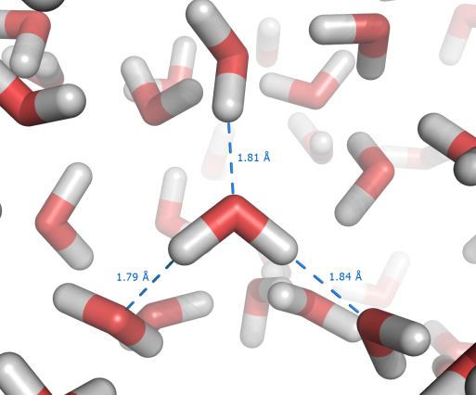
A disconnect between microscopic and macroscopic descriptions?
Microscopic or atomic / molecular
Macroscopic or ‘bulk’
Molecules obey the laws of mechanics (classical or quantum);
Based on evidence of molecular sizes, many variables O(10²³) are needed to characterize the system: r_{i} , v_{i} = dr/dt;
Motions occur on nm length scales and ps time scales;
Time is a critical variable in the analysis
Macroscopic systems obey the laws of thermodynamics
The system is characterized by a few variables: p, T, V
Processes occur on mm or larger length scales
Time does not enter the analysis
No reference is made to the atomic structure
Cannot determine quantities like equilibrium constants
Statistical mechanics starts with the microscopic picture and provides a framework for determining macroscopic properties.

Slide 5
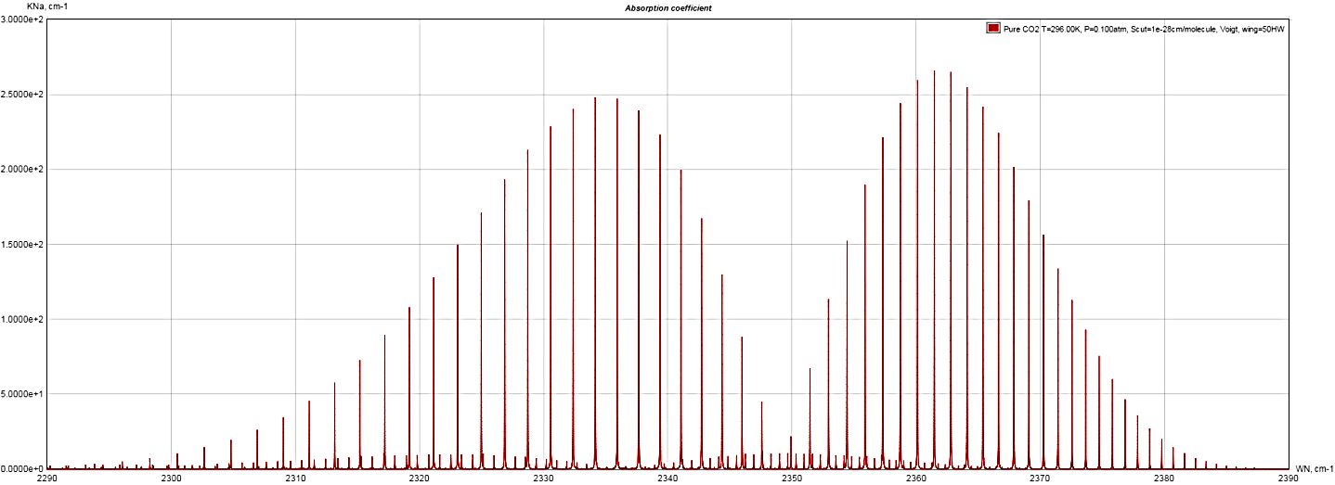
Applications of statistical mechanics
Statistical mechanics relates molecular structure to values of thermodynamic parameters of materials and their temperature / pressure dendence
-Heat capacity of metals
Statistical mechanics is used to predict / explain spectral features of gases
-Ro-vibrational spectrum of CO₂ gas

Slide 6
Setting the stage for Statistical Mechanics
Mechanics provides the fundamental picture to explain macroscopic systems
How do non-mechanical variables used in thermodynamics, such as temperature, entropy, and free energy, arise from the mechanical variables of the microscopic description of the system?
In mechanics time is a fundamental quantity, but it does not appear in equilibrium thermodynamics
The scale of atomic sizes and motions are so much smaller than macroscopic thermodynamic systems. nm and Å length scales
The key to the relation between mechanics and thermodynamics are the concepts of probability and in particular, the laws related to probabilities of phenomena with large numbers

Slide 7
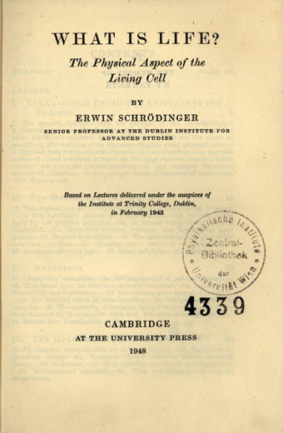
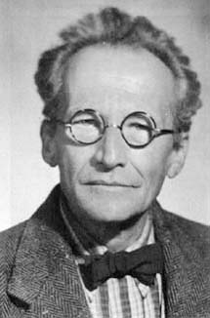
A consequence of probability arguments
Schrödinger poses the question: Why are atoms so small?
The length scale of atoms are 10⁻⁹ to 10⁻¹⁰ times smaller than macroscopic length scales we deal with
Typical samples of matter contain in the order of 10²³ atoms / molecules
Time scales of molecular level events take place on 10⁻¹² s

Slide 8
Why are atoms so small?
The complexity of life, even for simple unicellular organisms, necessitates the presence of many atoms in living beings:
https://www.youtube.com/watch?v=WFCvkkDSfIU
https://www.youtube.com/watch?v=7Hk9jct2ozY
Before complexity can even develop, macroscopic numbers of atoms and molecules are needed so the probabilistic behavior of individual atoms and molecules combine and lead to the emergence of stable and predictable environments suitable for the development of life. This is where the arguments of statistical mechanics come into play!

Slide 9
Statistical Mechanics: Beware!
“Ludwig Boltzmann, who spent much of his life studying statistical mechanics, died in 1906, by his own hand. Paul Ehrenfest, carrying on the work, died similarly in 1933. Now it is our turn to study statistical mechanics.
Perhaps it is wise to approach the subject cautiously.”
David Goodstein, States of Matter

Slide 10
Outline of classical and quantum mechanics used in this course
Classical Newtonian mechanics
Motion under constant force; harmonic oscillator
Motion of a polyatomic molecule: separation of center of mass, rotation, and vibrational motion (normal modes)
Lagrangian and Hamiltonian mechanics (“Analytical mechanics”) analyze motion based on other functions (kinetic and potential energies or total energy)
Phase space representation of motion simplifies the analysis and naturally arises from the Hamiltonian approach
Quantum mechanics
Time-independent Schrödinger equation
Particle in a box: one- and three-dimensions, many particles
Rigid rotor for rotational motion
Harmonic oscillator

